Slide 1
Business writing & recordkeeping
Tina Dressler

Slide 2
Effective business writing
Clear, complete & concise
Correct use of format: memo-usually interoffice; letter-external; minutes – should fill you in completely if you were not in attendance
Proofread & spell check everything

Slide 3
Effective business writing tipshttps://www.bdc.ca/en/articles-tools/entrepreneurial-skills/become-better-communicator/pages/10-tips-effective-business-writing.aspx
KNOW YOUR AUDIENCE
KNOW YOUR MESSAGE
THINK LIKE A REPORTER
BANISH BUZZWORDS & CLICHES
JUNK THE JARGON
KEEP IT TIGHT
MAKE IT PLAIN & SIMPLE
LEAVE SYMBOLS & ABBREVIATIONS ON YOUR PHONE
GET ACTIVE *
PROOFREAD

Slide 4
Rebates will be provided on all new purchases. Xyz will provide rebates on all new purchases.
Active sentence ? More clear and it brightens writing!

Slide 5
here = in this place
hear = to perceive sound with your ears
your = belonging to you
you’re = contraction of “you are”
there = in that place
their = belonging to them
they’re = contraction of “they are”
should’ve (not should of) = contraction of “should have”
could’ve (not could of) = contraction of “could have”

Slide 6
Recordkeeping
How to store/retrieve effectively
Manage time (more organized & efficient)
Manage information efficiently using effective file management
Don’t save unnecessary documents
Follow a consistent method for naming files & folders
Store related documents together
Separate ongoing work from completed work
Avoid overfilling folders
Make digital copies of paper documents with a scanner
Prioritize your files for action
Organize documents by dates
Use tickler files

Slide 7
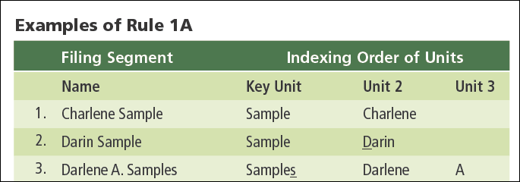
Rule 1: Indexing Order of Units
Personal names
The surname (last name) is first
The given name (first name) is second
The middle name or initial is third

Slide 8
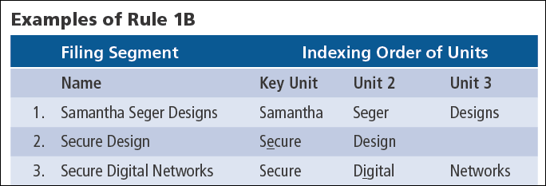
Rule 1: Indexing Order of Units
Business names
Indexed as written
Letterheads or trademarks used as guides

Slide 9
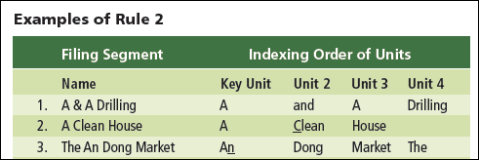
Rule 2: Minor Words and Symbols
Business names
Articles, prepositions, conjunctions, and symbols are separate indexing units
Symbols are spelled in full
“The” is the last unit

Slide 10
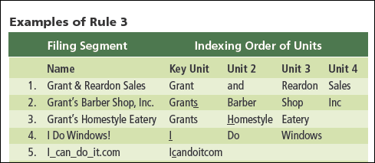
Rule 3: Punctuation and Possessives
All punctuation is disregarded
In business names
In personal names

Slide 11
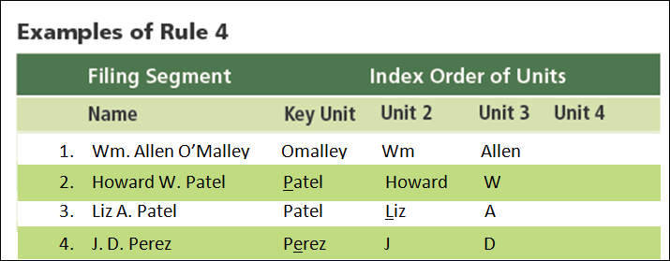
Rule 4: Single Letters & Abbreviations
Personal names
Initials are separate indexing units
Nicknames are indexed as written

Slide 12
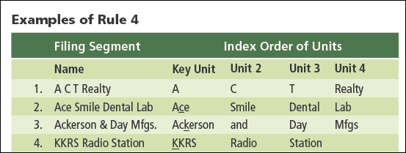
Rule 4: Single Letters & Abbreviations
Business names
Single letters are indexed as written
An acronym or abbreviation is indexed as one unit
Radio and TV call letters are indexed as one unit

Slide 13
Rule 5: Titles and Suffixes
Personal names
A title, seniority suffix, or professional suffix is the last unit
Numeric suffixes are placed before alphabetic suffixes
Single names with royal or religious titles are filed as written

Slide 14
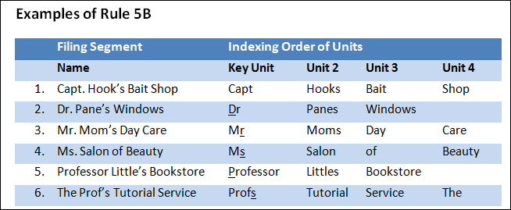
Rule 5: Titles and Suffixes
Business names
Titles and suffixes are indexed as written
“The” is the last unit

Slide 15
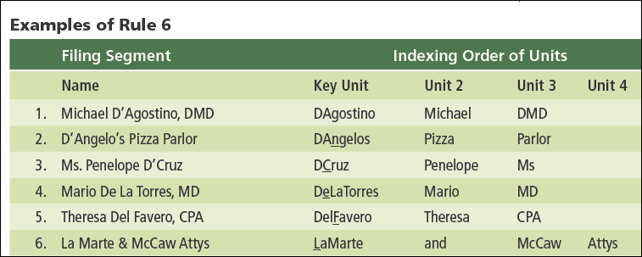
Rule 6: Articles and Particles
Business and personal names
An article or particle is combined with the name following it
Spaces are disregarded

Slide 16
Rule 7: Numbers in Names
Business names
Numbers spelled out are filed alphabetically
Numbers written in digits are filed in ascending order before words
Arabic numbers are filed before Roman numbers
For inclusive numbers, only the first digits are used
Ordinals (st, d, th) are disregarded
A number linked to a letter or word is a single unit

Slide 17
Rule 8: Organizations & Institutions
Filed according to the name written on the letterhead
Examples
Banks and other financial institutions
Schools, colleges, and universities
Hospitals, hotels, and clubs

Slide 18
Rule 9: Identical Names
For identical names, sort records by
City names first
State or province names second
Street names third
House or building numbers fourth

Slide 19
Rule 10: Government Names
For local and regional government names
The name of the county, city, town, or village is the first unit
The most distinctive part of the name comes next (examples: public library, fitness center, water works)
The type of office comes next (examples: county of, city of, department of, office of)
“Of” is not added to a name

