Slide 1
VaCMS-Let’s Figure This Out!
Spring 2019 Conference

Slide 2
Some Areas to look at
Inquiring clients/cases
Applications
Scheduler
Reprinting Forms
SNAP Fraud Claims
Security Officer Functions
Troubleshooting Issues

Slide 3
inquiries
Case Level Inquiry
Will search for that 1 given case number only…even if there are others out there
On left side navigation select inquiry
Select case
Enter VaCMS case number
Click
Next the challenge is to know how to read the results on the Case-Search/Summary Screen

Slide 4
inquiries
Client Level Inquiry
Best Practice to search this way!
Client could have up to 4 cases with conversion in VaCMS
Energy
Childcare
Medicaid
SNAP/TANF (VaCAP/ not converted correctly)
Use left side navigation to get to Inquiry
Select Client
Preferable enter SSN or First Name, Last Name & Date of Birth
Click
Results appear under search results on bottom of screen
All Client level searches will lead you to the same screen as case level inquiries once click on correct case number hyperlink

Slide 5
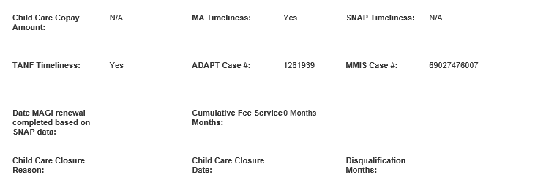
inquiries
Top Section

Slide 6
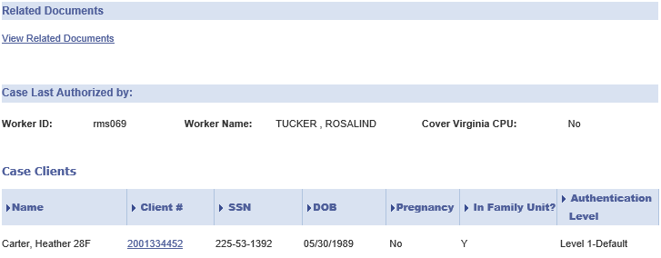
Middle Section
Short cut to Document Search screen & pre-populates case number for easier search
INQUIRIES

Slide 7
inquiries
Bottom Section
Don’t be afraid to click the bottom button…especially if you need to know why a benefit closed in eligibility summary

Slide 8
inquiries
How to Find the Narrative:
Click Data Collection
Click Case Action
Enter VaCMS Case # in box
Select Add Case Narrative in “what action do you want to perform” drop down
Click
Check to see if correct case with information on screen
If correct case, change drop down to yes
Click

Slide 9
inquiries
All Case notes will be listed - if there is any.
To access a particular date, just click the date hyperlink and the notes will come up
To add a case note, click
Remember your information will be as good as your workers puts in here
Should be able to view only data collection if have receptionist benefit programs privileges in VaCMS
Can edit case narrative without having eligibility worker privileges- case notes privileges

Slide 10
applications
Every locality uses preferred method to entering new paper applications
RDE vs. Application Screening
Regardless of method, it comes down to two things:
File Clearance
Case Association

Slide 11
Applications
Locality Inbox
Search for any applications received via the inbox…….
But don’t forget to check the review and change box as well in case application was converted
Make sure to clear Processing Unit to ALL and locality to blank
If you don’t then not searching for any applications that could be with CPU or other localities
The easiest way to search is T# or SSN (of any person on case on the application)
Dates by themselves are not always accurate or as reliable as the other 2 methods.
If application is assigned to XXX900 , but in your locality- then application at CPU

Slide 12
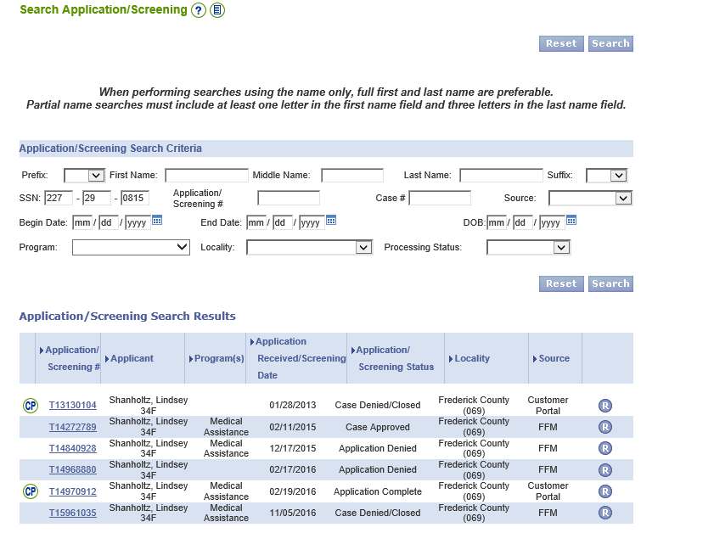
Applications
Locality Inbox
Taking Applications out of the Inbox – TIPS
Can not associate a T# to a case with an outstanding T# even if really old.
Must deny that old T# if possible(check with Supervisor) before can associate the new application to correct case
If pending application for client is still open or status is in redetermination or change mode, then new application must be worked by add a program…..possibly have to deny the T#.

Slide 13
Applications
File Clearance
Let’s look at the Process...
Possible matches will come up on this screen. Please select the following appropriate person:
Select VaCMS match radial dial first
If different client numbers appear, then look up in Spider to confirm which ID you want before moving forward
Select new client dial if nothing comes up for potential matches or no VaCMS option(s)
Click

Slide 14
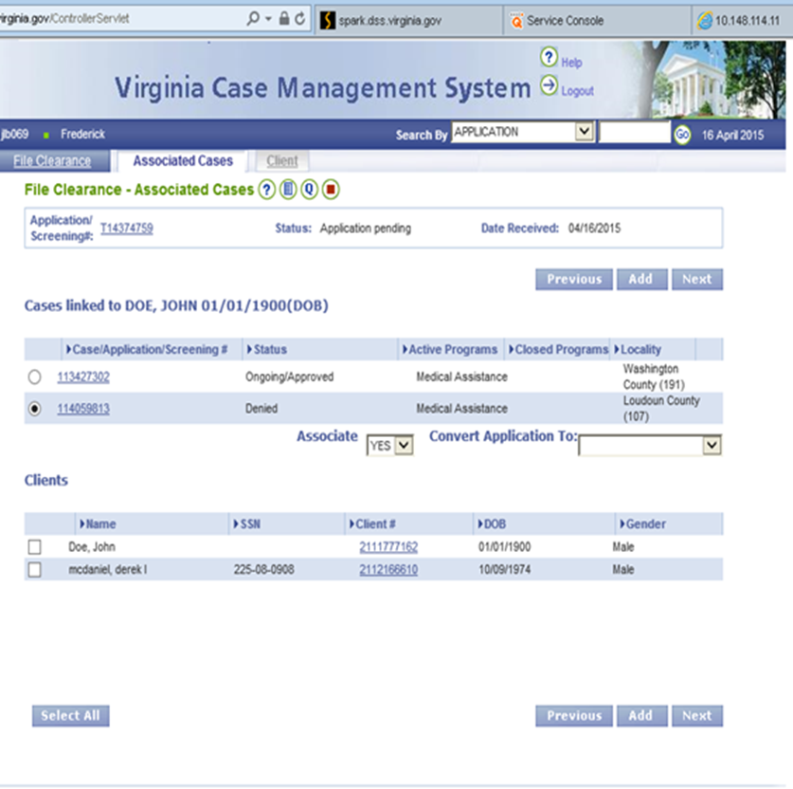
applications
Case Association
Click case number hyperlink to view case summary screen to see if this is the person’s case or someone else's case FIRST.
If same person’s case, you could associate cases per benefit type.
If not, do NOT associate this case.
Next, look at benefit program area:
SNAP/TANF/MA only
Energy Only
Childcare only
Next look at case status for determining if can be associated or needs to done by add a program instead
General Tip - Do Not associate to 999 case numbers, they are case holders for inactive cases with claims on them
2nd
3rd
1st
This is our screen to convert applications to renewals and change/add a person as well

Slide 15
Scheduler
Every locality can choose to use this function for Intake/ New application appointments, but it MUST be used for ongoing SNAP/TANF cases or else the NOE will go out blank with wording to contact their local agency.
Must be entered into the system by 14th of each month for the NOE/appt letter and review to be mailed out successfully the 17th of each month by central printing
Can only schedule 1 appointment for any given time period per worker – can’t overlap at all so need to watch ending appointment times when entering timeframes

Slide 16
scheduler
Searching for Appointments Tips
Searching for Appointment Tips
Easiest search is by Case/Application number
The worker user ID defaults to you, must click search button first, then can take out your ID and put in correct worker ID
If use date search and nothing else, will get entire state appointments
If need to see the appointment of change appointment click pencil
Once back on scheduling screen change date, time, change schedule to reschedule with reason, then click submit
We have had issues with rescheduling other workers appointments at this time

Slide 17
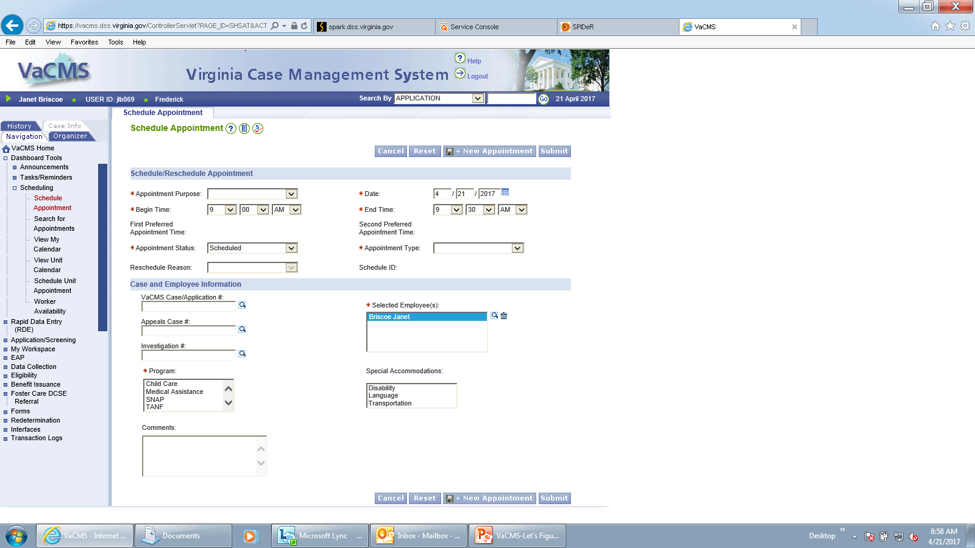
scheduler
Scheduling Appointment Tips
The begin time and end time pre-populate including AM/PM, so double check your time is accurate when filling in time
The selected employee pre-populates to you, if the appointment isn’t for you click the trash can, then click magnifying glass to select worker
To select more than 1 program (ex. SNAP/TANF) hold down the Ctrl key and click with the mouse
If inputting more than 1 appointment, click

Slide 18
Reprinting forms
Click DMIS
Click Document-Forms Search
This will allow you to pull up any generated form, uploaded or scanned document.
Enter Case #
If search by case number, all documents canned in by client will appear on search results if on case.
Click
The documents will appear at bottom, generally in received date/requested date order.
Once you found the document, click the hyperlink and document should pop up in PDF form.
Watch your date range
Tip: Usually can find generated forms quicker under Forms section(forms history) on left side navigation –since no date range.

Slide 19
Reprinting forms
If you don’t know the date, then:
On left side navigation click data collection
Enter case number & select view data collection read only in drop down
Click
Click folder icon
A list of everything scanned, generated or upload will come up

Slide 20
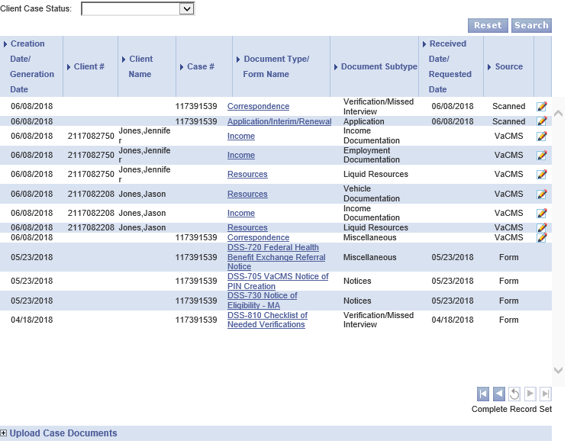
Reprinting applications

Slide 21
Snap fraud claims
How to find claims :
Click Benefit Issuance
Click Claims
Select View/Track claims
How to read the information given
1st: Look at the outstanding amount of the claim because this amount includes all payments made…including payments not posted by state yet.
2nd: The bottom will tell you all the payments made on claim.
Need to click circle at bottom of page to get the entire list on one page, then sort by date received to find the most current payment sometimes.
Consideration: Make a Claim spreadsheet to help keep track of all fraud claims in Agency since no available report…..especially helpful with possible RC.
1st
2nd

Slide 22
Snap fraud claims
How to Enter a Claim:
Enter payment Method
Enter Payment Amount
Enter Payer First & Last Name
Enter Receipt #
Enter Check/Money Order # (if applicable)
Enter Date Received
Click

Slide 23
Snap fraud claims
There are currently 3 types of reports at the moment
TOPS/Garnishment Report
Weekly Report based off cycle number on Thursdays
Not always consistent so might need to go back following week and run if gets no report found result
This includes Social Security Garnishments and TOPS
Will see every locality in State
Monthly Payment Summary Report
Monthly report that will be available on the 6th or after each month for the previous month
Claims Data Report
Monthly report that is available after the 1st of each month that has every claim in locality
Will have to separate by locality, then open versus closed claims
Is not necessary a good tool for recoupment, but good for checking claim status in VACMS

Slide 24
Security officer functions
Things to keep in mind for VaCMS…..
Make sure worker is set up in SAMS and possible build the profile in VaCMS
The profile can be set up by their Supervisor – this isn’t necessarily a security officer function
Double check your profile page in VaCMS has the correct workers and data in LDSS page
Check default workers listed specifically if changes in staff with Supervisor because they don’t always remember this page, just the employee page to make changes.
Roles can be confusing for Supervisors and workers a like to find the right combination needed
Ex. - If pulling Finance Report monthly must have more than just LDSS Finance – must also include all program wide inquiry minimum for report to show on up left side navigation.
Ex. – Must have Benefit Programs Receptionist role to enter appointment for other staff; not Benefits Worker

Slide 25
Troubleshooting issues
Remember to use your tools at hand
QRG’s
Page level help
See if anyone there knows the answer whether in your unit or outside your unit
If still stumped, network and see if another Agency might have the answer
It could just be a ticket!
Might have change internal process of Agency or your personal system to better fit VaCMS and all the upcoming changes…………. because there will be changes

Slide 26
questions
Janet Briscoe
Frederick County DSS
Email: janet.briscoe@fcva.us

