Slide 1
Energy Assistance Program overview
POSSESS Meeting 11/16/22
Presented by: Hagen Hicks, Energy Assistance Consultant

Slide 2
Energy Assistance Program (EAP) Agenda:
Fuel Assistance overview and payment information
Crisis Assistance overview and payment information
Other EAP-related programs
Future of EAP

Slide 3
Energy Assistance in Virginia
Virginia receives a LIHEAP (Low-Income Home Energy Assistance Program) block grant from the Federal Government, which is used to administer the Energy Assistance Program and Weatherization Program
State supervised, locally administered
Three components – Fuel, Crisis and Cooling
Runs on Federal Fiscal Year from October 1 – September 30
Extra components – EAP COVID, Supplemental Payments with ARPA and CARES Act funding

Slide 4
Fuel Assistance purpose
EAP Manual guidance: VOLUME IX, CHAPTER B, PAGE 1
  1. PURPOSE
  The purpose of the Fuel Assistance component is to assist eligible households in meeting their immediate home energy needs. The benefits are not intended to meet the household's total costs during the heating season.
  Fuel assistance helps with home heating costs; but can also be used for furnace re-starts, late charges, delivery charges, installation charges, and connection or re-connection fees.

Slide 5
Fuel Assistance applications
Applications are accepted from the first Tuesday in October until the second Friday in November. The application period is extended only if the deadline falls on a Holiday. This year, the application date is October 11 through November 14, 2022.
A household may file an application:
  Online at www.commonhelp.Virginia.gov/
  Through the call center by calling 855-635-4370, or
  They may complete and return a paper application to their local department of social services
Applications post-marked or submitted on or prior to 11:59pm the day of the deadline are considered timely.
In 2022, Local agencies have until December 8, 2022 to determine eligibility (approve or deny) on all applications received.
*Please note the exact calendar dates for the application period and deadline/Benefit Determination will vary each year

Slide 6
Implementation schedule / deadlines
The Implementation schedule can be found on the Energy Assistance Home Page on FUSION: https://fusion.dss.virginia.gov/bp/BP-Home/ENERGY-ASSISTANCE
Public website Energy Assistance page: https://www.dss.virginia.gov/benefit/ea/index.cgi
There is an Energy Assistance information sheet available on the Public Website. I’ve also sent a copy to Janet to forward to you all that you can keep for your reference. Income limits are updated for EAP each May.
Virginia’s EAP income limit is currently set at 150% FPL (federal poverty limit) which is the maximum FPL states are allowed to use.

Slide 7
Fuel Assistance Pre-approvals
Households who meet certain criteria, are preapproved to receive Fuel Assistance.
The preapproval process is an automated job in VaCMS that runs in September of each year.
Households who received Energy Assistance in the past year are matched with open SNAP cases, whose income has already been verified.
Preapproved households are sent a letter with the information that was used to determine eligibility and are instructed to call their local department of social services to report any changes.
Households who are not preapproved, have to file an application during the application period.
Being preapproved does not give the household a larger benefit than a household who files an application.

Slide 8
Benefit Determination (BD)
Benefit Determination is a process where all approved households are assigned a benefit amount.
A list of approved households and Credit Authorizations are sent to vendors by a central print vendor.
Copies of the materials that are mailed are available in VaCMS.
16 Fuel vendors (usually larger vendors) are sent Credit Authorization information by electronic file. For these vendors, billing files and payment information files are exchanged weekly during the payment season.
Vendors can begin sending payment requests to VDSS Home Office/EAP payment processors, once they receive the Authorizations.
Fuel payments are made from VDSS to the vendor within 30 days of receipt.

Slide 9
Fuel benefit payments
No payments are made to vendors until they bill VDSS.
Pledges are not typically made for Fuel Assistance approvals
Some vendors begin billing immediately in December, and some vendors choose to wait until January, or later.
The deadline for vendors to bill is late April (exact date designated by Home Office each year).
The only households who receive their Fuel benefit right away are direct pays.
The Fuel-After Benefit Determination PowerPoint 2020 guide on the EAP Training FUSION page is a great resource that has detailed information about how BD works https://fusion.dss.virginia.gov/bp/BP-Home/ENERGY-ASSISTANCE/Training-Documents .

Slide 10
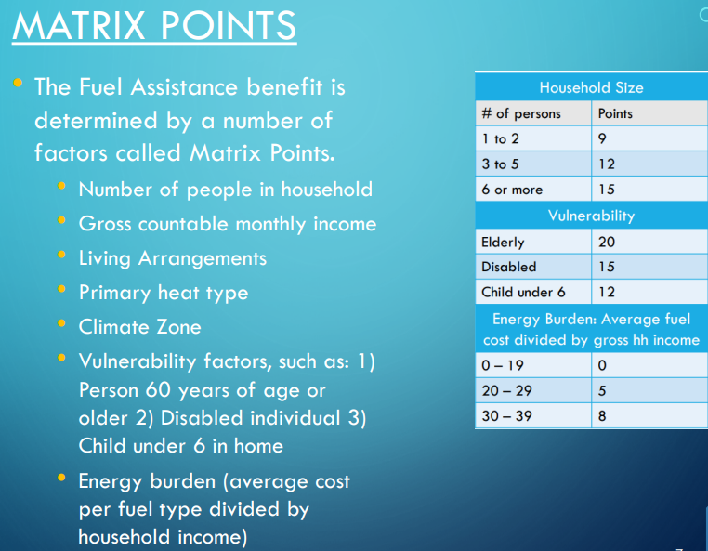
How is a household’s benefit determined?

Slide 11
Direct payments
  Why do some households receive Direct payments for their Fuel benefit?
Renters with Heat/Cooling Included in the rent.
When no vendor contract for the fuel type exists for the locality; or
When the LDSS determines the household's fuel storage capacity is less than 100 gallons; or
When the household's primary fuel type is coal or wood; or
When the household's primary fuel is liquid propane provided by a non-participating vendor; or
When the household's primary fuel is electricity or natural gas provided by a non participating vendor; or
When the household picks up oil/kerosene from an island pump; or
When the household’s primary heating or cooling payments are automatically deducted or drafted monthly from a bank account or credit/debit card.
For the full/comprehensive list, please see EAP Manual VOLUME IX, CHAPTER D, PAGE 6

Slide 12
Crisis Assistance
EAP Manual guidance: VOLUME IX, CHAPTER G, PAGE 1
  1. PURPOSE
  Federal law (Section 2604(c) of the Low-Income Home Energy Assistance Act of 1981 [Title XXVI of the Omnibus Budget Reconciliation Act of 1981, Public Law 97-35, as amended])requires each state to provide energy crisis intervention. This intervention must resolve the energy crisis of eligible applicants within 48 hours, or 18 hours in a life-threatening situation. A crisis situation is considered life-threatening if 1) the temperature is projected to be 32 degrees or less and 2) the household includes at least one vulnerable person (an individual who is under age 6, age 60 or older, or disabled).

Slide 13
Crisis Assistance
Applications for Crisis Assistance are accepted November 1 through March 15. Applications will continue to be processed, services performed by vendors and Authorizations paid through the end of April.
Services offered November 1 through March 15 are:
  Heating equipment repairs
  Purchase/replacement of heating equipment (homeowners only)
  Supplemental Maintenance
  Portable Space Heater
  Security Deposits (LP gas, Natural Gas, Electricity)
  Emergency Shelter
Services offered January 1 through March 15
  Above items +
  Payment of Primary Heat Utility bill (natural gas, electric bills)
  Purchase of Primary Home Heating Fuel

Slide 14
Can a household receive both Fuel and Crisis Assistance?
A household can receive both Fuel and Crisis Assistance.
If a household was approved for Fuel Assistance and they apply for payment of Primary heat utility or payment of Purchase of Primary Home Heating Fuel, they must exhaust their Fuel benefit first before they can be approved for Crisis Assistance for those service types.
In most instances, the worker can verify the benefit has been exhausted by looking at the payment history in VaCMS, or contacting the vendor.
If a household received a direct pay for Fuel Assistance, they must keep their receipts to be able to receive Crisis Assistance for another bill payment or purchase of fuel.

Slide 15
Crisis payments
When a household is approved for Crisis Assistance, a Credit Authorization (CA) is mailed to the vendor from VaCMS by the central print vendor.
Since it may take a few days for the vendor to receive the Authorization in the mail, a Notification of Eligibility form should be sent to the vendor, for equipment related services.
For bill payments, pledges should be done to prevent disconnections, budget removals, etc.
After the vendor has received the CA, they will confirm the amount needed to be paid (if it is a bill payment) then they will complete and send the CA back to the local agency. The local agency will then key the payment into VaCMS.
For equipment related services, after the service has been performed, the vendor will return the completed CA along with the itemized invoice to the local department of social services for payment.
Check/payment runs take place each Tuesday and Thursday evening during the Crisis season. Checks are then printed and mailed by the Department of Treasury in Richmond two business days after the check/payment run takes place.
VDSS is moving towards electronic payments to vendors, but as of now, they are still paper checks.

Slide 16
Weatherization Assistance Program (WAP)
15% of LIHEAP funding in Virginia goes towards Weatherization/Wx
Weatherization is administered by DHCD (Department of Housing and Community Development)
The Weatherization Assistance Program (WAP) reduces household energy use through the installation of cost-effective energy savings measures, which also improve resident health and safety. Common measures including sealing air leaks, adding insulation, and repairing heating and cooling systems. WAP does not offer assistance with paying utility bills.
Local agency staff should become familiar with their local WAP provider so they can refer clients to them directly.
For more information, please visit: https://www.dhcd.virginia.gov/wx

Slide 17
Low Income Household Water Assistance Program - LIHWAP
LIHWAP is a temporary, federally funded program created to provide assistance to low-income households, particularly those with the lowest incomes that pay a high proportion of household income for drinking water and wastewater services.
LIHWAP can assist with the payment of arrearages for disconnected households or those households who are at risk of disconnection (within the next 30 days after application). LIHWAP is now available to eligible Virginia residents. LIHWAP assistance will be available through September 2023 or until funds are depleted.
Customers who have questions about the program and/or wish to apply should be referred to Promise Network at 1-888-373-9908 from 7 am- 7 pm Monday – Saturday or https://virginialihwap.com.
*There is a Broadcast on FUSION dated 10/18/22 with this information

Slide 18
Future of Energy Assistance in Virginia
In January 2020, Virginia EAP was audited by the Department of Health and Human Services.
HHS recommended that Virginia offer Energy Assistance (Crisis Assistance at a minimum) year round.
This is a long term goal and details about how it will be implemented are not yet determined.
There is no start date/timeline for this goal. Input from local agencies is welcomed.

Slide 19
Percentage of Income Payment Program “PIPP”
The General Assembly passed legislation in 2020 and in 2021 regarding the implementation of the Percentage of Income Payment Program (PIPP)
PIPP will assist low-income households reduce their energy burden by limiting electric bill payments directly to no more than six percent of the eligible participant's annual household income if the household's heating source is anything other than electricity, and to no more than 10 percent of an eligible participant's annual household income on electricity costs if the household's primary heating source is electricity.
PIPP will reduce the amount of energy used by the eligible participant's household through participation in weatherization or energy efficiency programs and energy conservation education programs.
Dominion Energy and Appalachian Power (AEP) are the only two electric companies that will be participating in PIPP at this time; PIPP is funded by a universal service fee collected on all customers for these two vendors.
PIPP will not be available until mid to late 2023

Slide 20
Energy Assistance team members
EAP Manager: Denise Surber denise.t.surber@dss.virginia.gov
EAP Consultants:
  Hagen Hicks hagen.hicks@dss.virginia.gov
  Kim Hudson k.hudson@dss.virginia.gov
  Sean Nagle (as of 11/10/22)
  Catherine Pond catherine.pond@dss.virginia.gov
LIHWAP / PIPP Consultant:
  Angela Ector angela.c.ector@dss.virginia.gov
EAP Vendor Coordinator:
  Sandra Spady sandra.spady@dss.virginia.gov

