Slide 1
The role and function of the ram
Chris Powell, Eastern Regional Administrative Manager,
Local Engagement and Support

Slide 2
Housekeeping
This presentation is intended to be very interactive.
Feel free to ask me any questions at any time.
I will attempt to address most questions during this session
In consideration of time and/or circumstances some questions may be addressed after this session.

Slide 3
About me
Chris Powell, Eastern Regional Administrative Manager
Began my career at Hampton Social Services in 1999.
Worked in Benefits Programs for a total of 7 years.
Worked for Williamsburg Human Services for 20 years.
Was Deputy Director of WDHS for 16 years.
Became the Eastern Regional Administrative Manager in April of 2022.

Slide 4
What does a ram do anyway?

Slide 5
What does a ram do anyway?
Assists the Regional Director with initiating, developing and sustaining dynamic, collaborative partnerships with Directors of local departments of social services (LDSS).
Supports the Regional Director, LDSS directors, and staff by reviewing, monitoring, and evaluating business practices, promoting the efficiency and effectiveness of fiscal, human resource, administrative, and operational programs.
Delivers training for LDSS directors and staff to improve business practices.
Provides feedback to the Regional Director and Virginia Department of Social Services (VDSS) Executive Leadership Team on issues that affect LDSS operations and/or VDSS policies and procedures.
Notes:
Taken from my EWP, What is a ram exactly and what are the functions of responsibilities of a ram on a typical day.

Slide 6
What does a ram do anyway?
Regional Administrative Managers (RAMs) assist the Regional Directors (RDs) with initiating, developing and sustaining dynamic collaborative partnerships with local agencies.

Slide 7
What does a ram do anyway?
Regional Administrative Managers (RAMs) assist the Regional Directors (RDs) with initiating, developing and sustaining dynamic collaborative partnerships with local agencies.
Notes:
So, where does this begin?

Slide 8
Budget
Preparation and Periodic Reviews
The 20% Variance Report
Approval of BL858 BRS
Overall monitoring
Revenue Maximization in accordance with GAAP
Notes:
Generally Accepted Accounting Principles

Slide 9
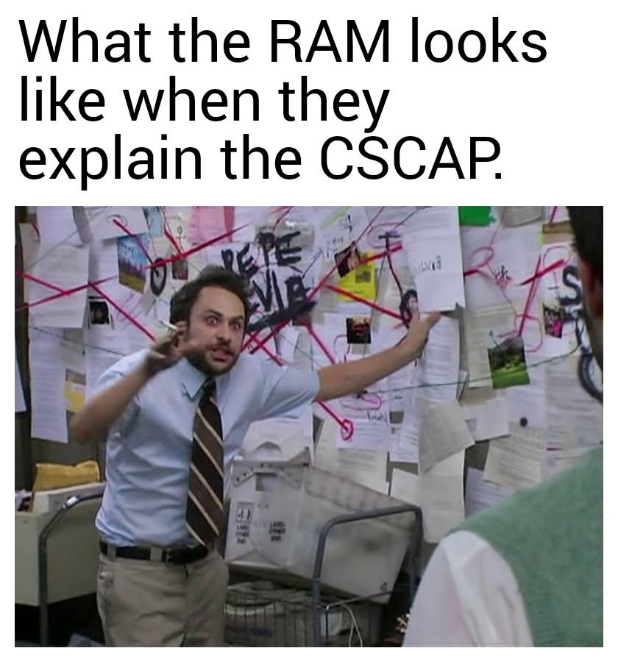
Cscap translation and demystification
The Central Services Cost Allocation Plan must be certified annually by the Director.
Some can be over 350 pages
They get audited
A lot

Slide 10
But wait, there’s more!
RAMs may be a part of larger project teams for organizational assessments and process improvements or, dependent upon skills and experience, lead specific improvement initiatives. Consultation with Local Engagement and Support Division leadership and staff will help to determine the approach and resources needed for each initiative.
Notes:
Budget training for covlc
Local board member training
Targeted communications from the state

Slide 11
What does a ram do anyway?
Part 2: the software
Budget and Finance
LASER
BRS
Human Resources
LETS
Operations
Administrative
RMS
Notes:
What areas or administrative functions you assist in
Notice that Thomas Brothers is not on this list.

Slide 12
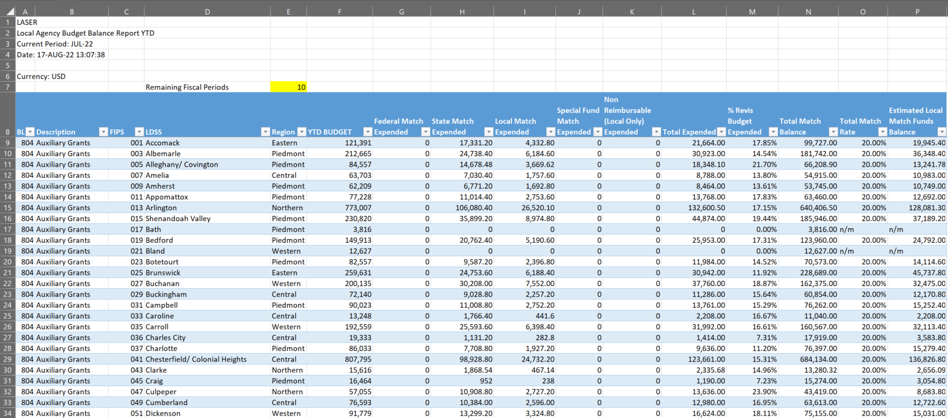
Laser Budget balance report
On FUSION, posted monthly

Slide 13
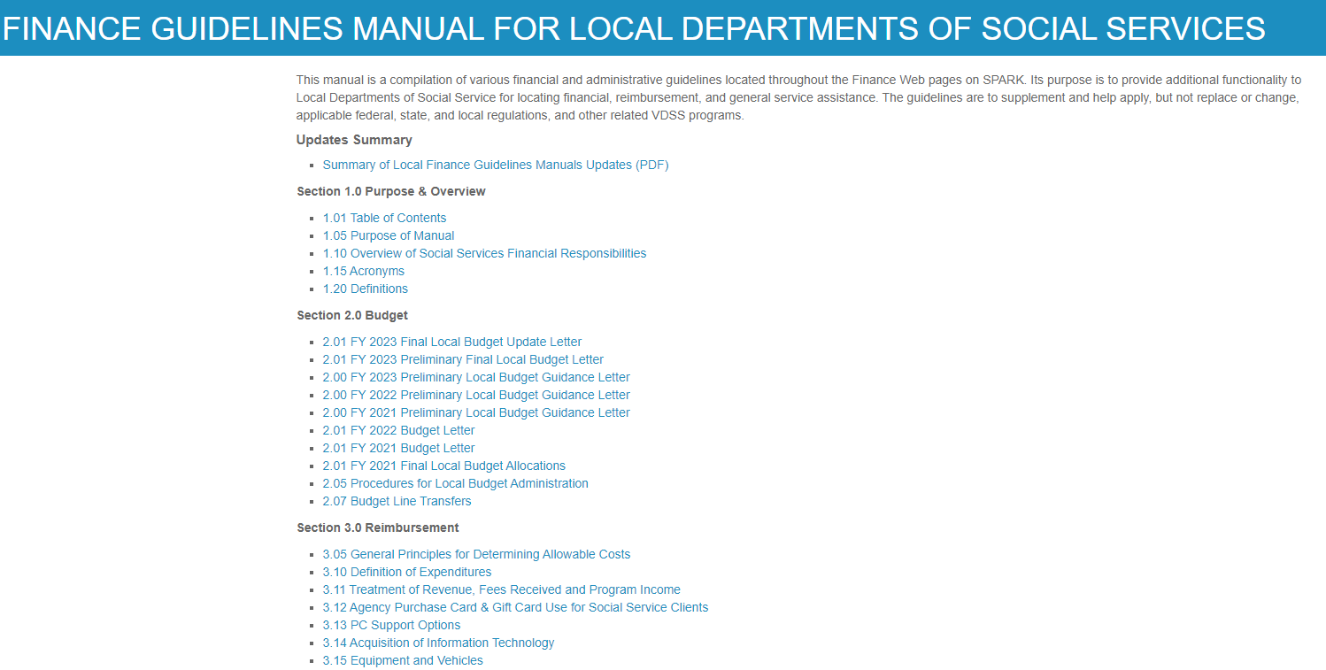
The finance guidelines manual (fgm)

Slide 14
Fgm continued

Slide 15
What does a ram do anyway?
In short: Building Bridges
The RAM acts as CONSULTANT, providing technical assistance to the local agencies (LDSSs)…
…acts as an ADVOCATE for the LDSS to the State…
…communicates State policy and directives to the LDSS
…offers training in State policy where needed.
Notes:
NEXT LASER REPORT

Slide 16
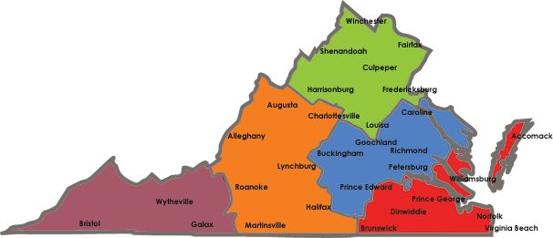
How many rams are there?
Hint: the answer is five.
Notes:
There is one RAM per region. The RAMS answer directly to the Regional Director.

Slide 17
Where and who are the rams?
Central: Sandy Graham, sandy.graham@dss.virginia.gov
Eastern: Chris Powell, christopher1.powell@dss.virginia.gov
Northern: Will Hoff, will.hoff@dss.virginia.gov
Piedmont: Kathleen Hubert, kathleen.hubert@dss.virginia.gov
Western: Andre Richmond, andre.richmond@dss.virginia.gov

Slide 18
Q AND A

Slide 19
Thank you

