Slide 1
Tips & Tricks
For MS Outlook and Teams

Slide 2
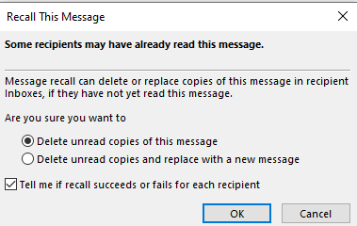
Recall Messages in Outlook
Recalling emails:
Once email has been sent, open email wishing to recall in sent box in Outlook
Select “File” at top and then click “recall/resend” button or option
Message appears and can select to replace message if needed
If want to know if successful, then check the box, then click “ok” button.
Only will work on unopened or unread emails

Slide 3
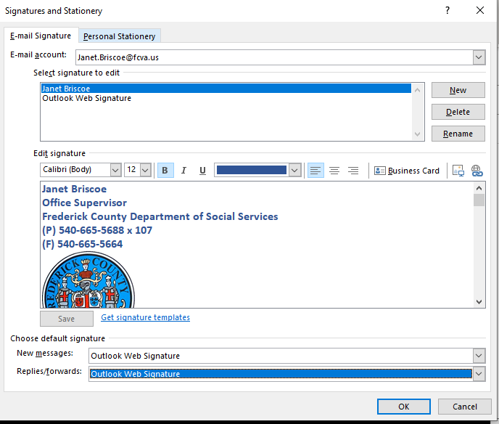
Creating Signatures in Outlook
Open a new email in Outlook
Select “Signature” button on top of email
Select “new” button on side to create and name
Create signature in body section below:
Can include pictures or statements
Include all Contact Information
Once saved new signature please select in drop down in “choose default signature” for new and replies/forwards
Or could create 2 different signatures with one for each!

Slide 4
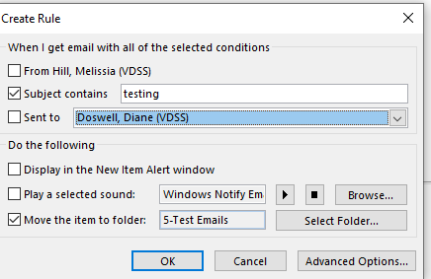
Creating Rules for EMail
Create file folder you wish email to go into in your Outlook Inbox
Under the “home” tab, select “ rules” button on top in the ribbon
Select 1 option on the top of how you wish the email to be sorted to the file folder
From a specific person
Subject line
Sent to(if multiple people should be on email)
Select 1 option from the bottom section
If want file folder select folder button to find the one made by you in Outlook

Slide 5
Creating Rules for Email
If need more advance options , click” button on right hand side
Follow each step closely the language in “step 2” should be exactly what should happen and where the file needs to go.
By clicking the blue hyperlink lets you change it.
Using the advance option will allow you to make exceptions in your rule

Slide 6
Outlook emails &Calendars
Renaming Category Names:
Click “categories” button on top of page
Select “all categories” option
On box to the right, click the color you want to rename then click ”rename” button
Type new name in place of category color and click “ok” button to take

Slide 7
Outlook emails &Calendars
New Color Categories:
Click “new” button and
Select new color and name on pop up box
Click “ok” and now will appear on the list
Click “ok” button again to save changes
The categories will be the same for both emails and outlook appointments…can sort by category color in outlook for better sorting/search options

Slide 8
Outlook Calendars
Responding to Meeting Invites:
Instead of just clicking on the “accept”, “tentative” or “decline” buttons at the top, select the arrow under the appropriate response
If the meeting person doesn’t require or need to know if you plan on attending(which is most meetings if mandatory or mass meetings), select the drop down of “do not send response”
If can’t make meeting, but still need it then the “propose new time” button is great but only for smaller to one on one meetings

Slide 9
Outlook Calendars
Picking Calendars certain colors:
Go to your list of calendars
Right click on calendar name
Pick color option, not automatic and calendar will remain that color each time it is opened
This is helpful if you have many calendars and same color might help keep them more easily recognizable between them on the screen

Slide 10
Microsoft teams-meetings
Check your speakers/sound working:
Select more button at top (the one with the three dots)
Select settings and check where sound
Should be on speakers , not headphones

Slide 11
Teams meeting backgrounds
Change your background so no one sees behind if not appropriate:
Select “more” button on top
Select “ background effects”
Select one from the choices below by clicking on it
Click “apply” button for background to take effect
Great for when you have meetings and are at home!

Slide 12
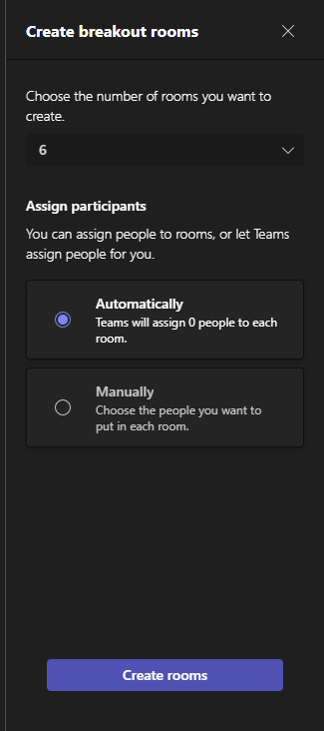
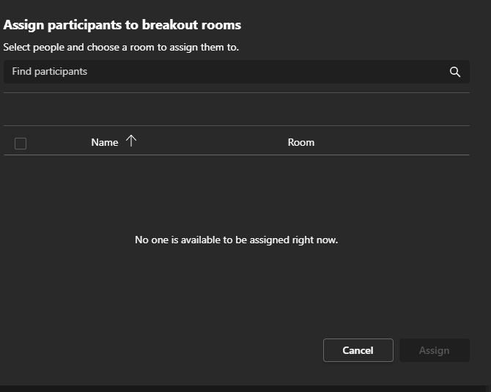
Teams meeting Break Out Sessions
Click “rooms” button on top of screen
Select the number of breakout rooms you wish to have(based on number of attendees)
Click the radial dial if you wish random or manually pick which person in to which group
Click “create rooms” button
New pop –up assigning to assign participants to rooms
If manual assign room number next to name
If automatic, rooms will be assigned out
Once all participants are assigned, click “assign” button
Rooms will start once click “open button” and when time is up click “close button” to go back to main meeting

Slide 13
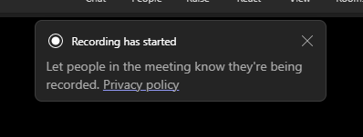
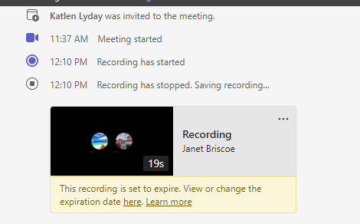
Teams Meeting-record option
Select “more” button from top of screen
Select “record and transcribe” on drop down menu
Select “start recording” from options
A pop up message will appear when the recording starts
To stop the recoding same steps but option to “stop recording”
The recording will appear in the meeting chat to review or listen to again
Click the hyperlink to see recording expiration and to extend the recording life on top of the recording click “…” button and can download recording for all future use on computer

Slide 14
Teams-Outlook shared Group
Please see the hand-outs for instructions and how the groups work and set up.
Work thru shared group start to finish with features with an example

Slide 15
Questions
Janet Briscoe
Janet.Briscoe@fcva.us
(540) 665-5688 x 107

