Slide 1
Customer Service
Don’t Just Be Good, Be Great

Slide 2
Topics To Be Covered
What does GREAT customer service mean to you?
Tips for GREAT Customer Service
Different Personality Types
How to Overcome “Negatives” or Complaints
How to Deal with Difficult Customers
Role Playing Exercise

Slide 3
What Does GREAT Customer Service Mean to You?
Smiling face or friendly smile
Courteous or attentive to need or problem
Listening to person
Telling correct answer - even if not what the client wants to hear
Knowing when you need to pass the client to another worker because you don’t know the answer
If you say you are going to do something, do it!
Follow up with client
Try saying it in your head first to make sure what you are going to say makes sense

Slide 4
What Does GREAT Customer Service Mean to You?
How is customer service measured
It is measured by the customer’s personal perception
This will differ from person to person and even situation by situation
Does that mean you can do the same thing every time?
NO- not fair, but true
Must read individual customer’s personality and mood to accurately not only give great customer service, but have them come away with the perception of great customer service.
“Great customer service can diffuse many bad situations before they even happen without even knowing it.”

Slide 5
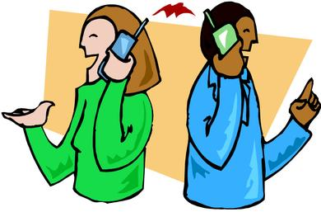
Tips for Great Customer Service
Facial Expressions – including a warm, friendly smile
Smile even when on the phone talking to customers
Tone and Tone Infliction
How something is said is just as or more than important than what is said
Body Language
Keep open body language at all time
No crossed arms
Keep torso area straight at customer while listening, especially introduction
Slit head tilt is physical sign of empathy- use when appropriate
Actively listen to customers in person and in person- not passive

Slide 6
Tips for Great Customer Service
TALK
Say “Hi, how are you today?” to start. This is more personable to customer from the beginning.
If customer says ok or answers something back respond or acknowledge you hear them.
If asked, how are you make sure you answer first, then move to, “How can I help you today?”
Explain
Explain what you are going to do or currently doing to customer whether or not he/she can see you
Try to give the “why” to the customer. Sometimes explanations go a long way
Know
Know when you can assist and when you need to pass it to another worker
Try to give some background info to the next worker so customer doesn’t have to repeat themselves as much as possible
Remember
Remember to show empathy to customers as needed
Sometimes the customer just wants someone to care or listen to them-it’s ok

Slide 7
Different Personality Types
There are generally 4 different personality types of customers:
The Director
The Analyst
The Belonging/Relater
The Socialiser

Slide 8
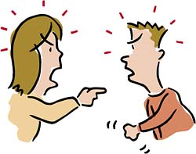
Different Personality Types
“The Director”
Customers who are comfortable taking charge and know what they want and when they want it.
These customers may present as demanding, can seem intimidating, and unwilling to consider alternatives
Traits:
No small talk(right to the point)
Make quick decisions
Want things done within certain timeframes
Doesn’t like “middlemen”
How to Handle:
Give facts clearly and immediately
Allow them to make their own decisions
Keep suggestions short and relevant
Never offer roadblocks to their goal- give solutions

Slide 9
Different Personality Types
The “Analyst”
Customers seek information and assess all possibilities before making a decision.
These customers may present as “wishy washy” on what they want or need to do.
Traits:
Love facts, details and descriptions of services
Don’t need small talk- be direct
Appreciate and respects doing what you say you are going to do
How to Handle:
Provide facts, data, specific policies, when giving an explanation and ensure you have back-up for this.
Be upfront, never beat around the bush and give all data to them at once, not piece by piece.
Allow them to come to the same conclusion thru their process.

Slide 10
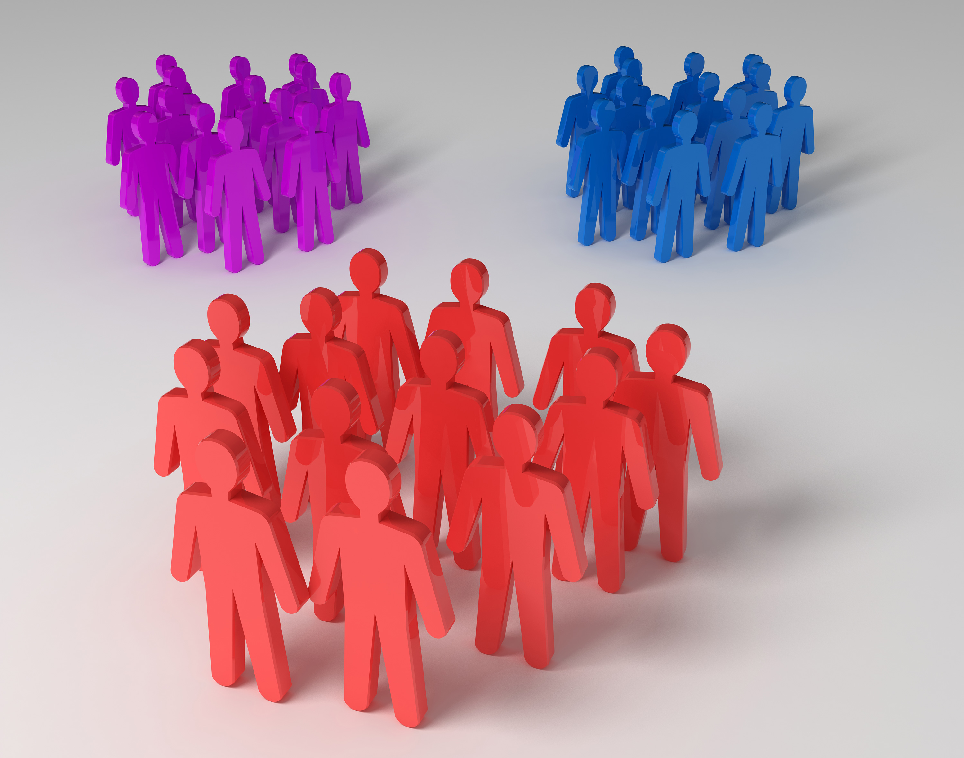
Different Personality Types
“The Belonging/Relater”
Customers feel a strong need to be part of a group to fit in.
Most of this types know someone else who is also on services and wants what others get.
Traits:
Networking and being in the “know” or not “left out” is important
Will share their perceptions and experiences with others- good or bad
How to Handle:
Ask their opinion- they love to give it
Include them in the decision making process- give them more general information so customer knows how he/she fits into the “system” or process so doesn’t feel left out.

Slide 11
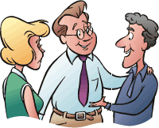
Different Personality Types
“The Socialiser”
Customers that love conversation and establishing new relationships.
They want to create new friendships and loyalty is important to them.
Traits:
Want a personal relationship- no data needed
Will ask for same person even if not who they need but trust that individual
Will not listen or believe you unless they like you and have an established relationship
How to Handle:
Let them talk- build that relationship
Use their name- key part to feel special and develop that relationship
Always do what you say you will do and follow-up with these customers to continue building relationship

Slide 12
Different Personalities Type
It isn’t always easy to determine what type of personality a customer is because he/she could be mix or the interaction might be brief.
Most of our difficult customers does fall into one type or another though
Once you realize what type the customer falls in, then apply some of the helpful hints to better “serve” that customer in their perception.
Just because you know and react to their personality doesn’t mean the customer will not still throw you negatives or complaints.

Slide 13
How to Handle Negatives or Complaints
I approach it with the 3F’s: Feel (empathy), Felt (relating), Found (solution)
This approach allows you to empathize, understand the issue, and overturn it with a more personal approach- not systematic.
Example:
Negative: “ I already faxed that last week. You guys are always losing my stuff. Now, I don’t have my benefits”
Statement: I get your concern about the Agency losing your paperwork. I feel the same frustration when it happens to me at my doctors office. I have found that calling or following-up once I sent it the fax to verify that it was received, helped solve my problems ahead of time before getting negatively impacted. This might help you to follow-up because we will always check for you if a document is here, so we can timely get you your benefits if deemed eligibility.
Remember to adjust process below to different personality types below:
Director: Be more direct, don’t need the empathy or relating piece. Customer does want tangible direct solution though
Anaylst: Give more details in solutions- don’t need empathy part. Customer wants facts and data. At end could even make question.
Belonger: Give everything, but instead of personal situation give group issue and solution.
Socialiser: Give everything – want that relationship

Slide 14
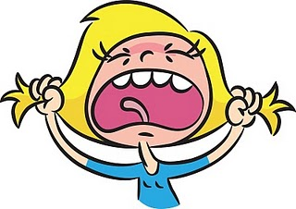
How to Deal With Difficult Customers
Always stay calm…..never show agitation because it will make it worse
Try to figure out what type of personality the customer is to adjust approach
Diffuse the situation
Never say, “calm down” to customer
Show and state that you understand why they are frustrated or angry
Most of the time there is a very valid reason why the person is upset
Let them know to help, you need them to explain the “situation” calmly, so they don’t leave anything out and you can better help them
Once they do calmly explain, actually help them.
Help: defined as answering their question(s) or physically getting the appropriate worker to answer their question(s) or Supervisor
If you do NOT follow thru, you will get another “meltdown” of the customer
Sometimes just talking with Supervisor will calm them down and make them “happy”
When all else fails and customer will NOT calm down, you either must get a Supervisor or ask them to leave or hang up- must give warning to customer before telling to leave/hang up.

Slide 15
Role Playing Exercise
Scenario #1:
Problem: Customer didn’t receive their SNAP benefits this month and now has no food in their house
Client: He/She is an “director” type and is very impatient since her children are “starving” because of us.

Slide 16
Role Playing Exercise
Scenario #2:
Problem: CPS just took their grandchildren into custody and are yelling at you in the lobby about the situation.
Client: They is a “be longer/relater” and feels the children were taken incorrectly and are being discriminated against because they are poor.

Slide 17
Role Playing Exercise
Scenario #3:
Problem: Homeless customer who needs to pick up EBT card but has transportation issue.
Client: He/She is “socialser” type and needs to rely on another person for a ride to pick up car and can’t make it until 4:25/4:30PM tomorrow to get there. Is very worried that the office will close before she gets there and will not be able to get the EBT card and eat finally.

Slide 18
Role Playing Exercise
Scenario #4:
Problem: A co-worker comes up to your desk and you are on the phone with someone else. Once you are done with the other customer “jumps” you with questions about why you sent a particular phone call to them.
Client: He/She is a “analyzer” type and is frustrated because he/she feels you sent the call to the wrong person since he/she is not their worker. Then proceeds to try to tell you where that phone call should have gone instead.

Slide 19
Role Playing Exercise
Scenario #5:
Problem: Free style – Person picks
Client: Free-style: Mix 2 personality group- person picks

Slide 20
Questions janet.briscoe@fcva.us

