Slide 1
DMIS
The Tale of Two Queues

Slide 2

Topics to be Covered
Where can the two queues be found?
Failed Queue Processing
Completed Queue Processing
Impacts for Document Processing
VACMS Searches /Changes
Questions

Slide 3
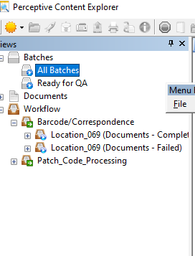
Where can the two Queues be found?
Both queues can be found in Perceptive
Content after the regular QA process
    All pages together will be grouped together in the batch for QA – not separated out per client/case scan as before
          It will separate after QA is completed correctly to scan level
    This will only effect all documents put thru barcode/automation process
Select Batches arrow down or Workflow on
main tool bar
    Can select either All Batches or Ready for QA if select Batches arrow
    Under workflow can select directly
Expand Barcode/Correspondence
Select which queue you need
    Completed Queue
    Failed Queue

Slide 4
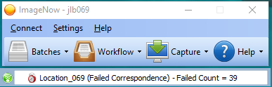
Failed queue processing
How do you know if documents failed?
    Can see the alert scrolling at the bottom and the “sun” in the top left corner will flash between colors as well
    This doesn’t necessarily mean you individually have documents that failed though because it shows for the entire Agency for the count
    Tip: This is not always immediately for documents moving to the failed queue after QA processing. Sometimes it takes about 5 minutes or so. Back out of the Batches screen, then reconnect back in.
After going back into batches and selecting failed queue, find and expand your LDAP initials
    Expand the date(s) that you have failed documents
    Tip: Try to have the documents in front of me if possible when processing of the final document at first to get used to the process, then once comfortable do not need this necessarily
This Photo by Unknown Author is licensed under CC BY-ND

Slide 5
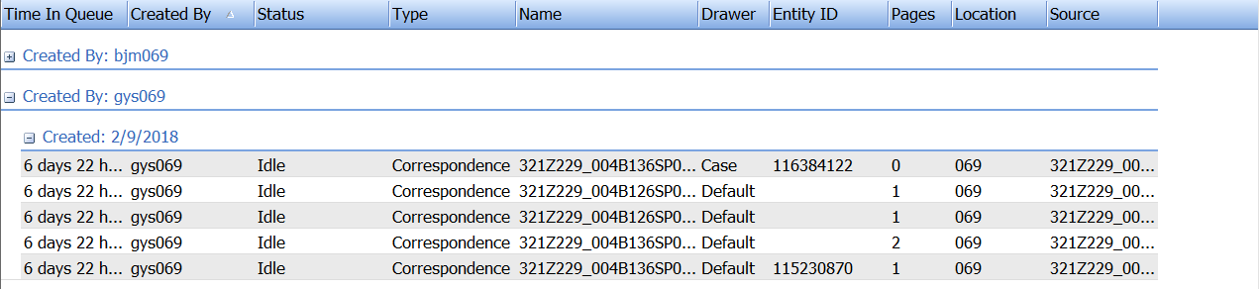
Failed queue processing
There are 2 different types of failed documents:
    Failed primary barcodes = knows case #, but default is missing
    Failed primary and secondary barcodes = missing default and case number
Doesn’t really matter….check both when processing to fix whatever is needed

Slide 6
Failed queue processing

Slide 7

Failed queue processing
Once everything is corrected in the green section, click the save button or select file then in the drop down save as.
If single page once saved, route forward to the completed queue (red circle on page)
Close all documents before moving to completed queue
Tip: Process all of the failed queue first before going the completed queue to merge documents to save some time.

Slide 8

Failed queue processing
A document was scanned incorrectly?
  Individual pages can be deleted in the thumbnails below, so only deleted certain pages if attached incorrectly or accidently ok’ed in QA process.
  Can also move pages around in thumbnails, so can put in correct order if original was out of order.
  If all pages in a document failed, you can fix the properties and route forward.
How to delete an entire document?
  On document list, right click on document(page) you wish to select and pick delete (big red X symbol next to it) or select the big red X from tool bar

Slide 9
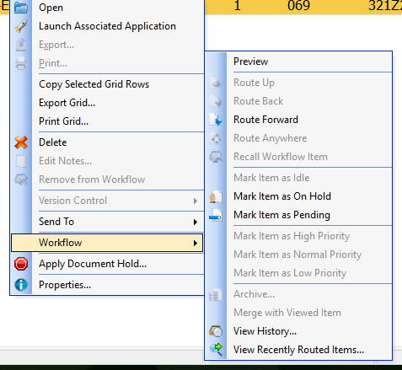
Completed queue processing
The object of the completed queue is to merge the failed queue document pages into the rest of the completed document
Once you are in the completed queue, find your LDAP initials and correct date to match failed queue document(s) you are working on
    Tip: use the search function to find matching document in the completed queue
Open the completed document, then minimize, then go back to failed queue
    Tip: get to both queues from batches view, instead of workflow. Easier to go back and forth.
Once in failed queue, select the matching document page you wish to merge, then right click and select merge with open viewed document from the drop down.
    There will be a box that pops up verifying that you really want this to happen and select yes to finish the merge.

Slide 10
Completed queue processing
Once all pages are merged into one document, then change thumbnails around to correct page numbering.
  Just drag pages around to correct order
Once pages are all in order, the document should be correct in VaCMS almost immediately
After all document pages are merged following this process, there should be nothing left in the failed queue

Slide 11

Impacts oN DOCUMENT PROCESSING
Positives:
  Scanned documents go into VaCMS almost immediately or more timely.
  Less confusing- only 2 options from scanning in Imagenow (barcode/automation process or patch code)
  Can correct scanning errors after the fact without deleting in VaCMS
  Can scan barcode automation and correspondence auto processed in same batch- time saver!
Negatives:
  Found some individual workers don’t have completed queues on main screen. Can find them though thru the filters- created by and LDAP ID then hit GO button.
    Tip: Save filter so can easily get to next time without doing the same filter each time.
  Documents will automatically go to VACMS even if not completed or work failed queue yet. Documents scanned in will hit the document inbox for the eligibility worker with scan.
    If uploaded from computer or scan from another copier then document does not go to document inbox and no notification to eligibility worker.

Slide 12
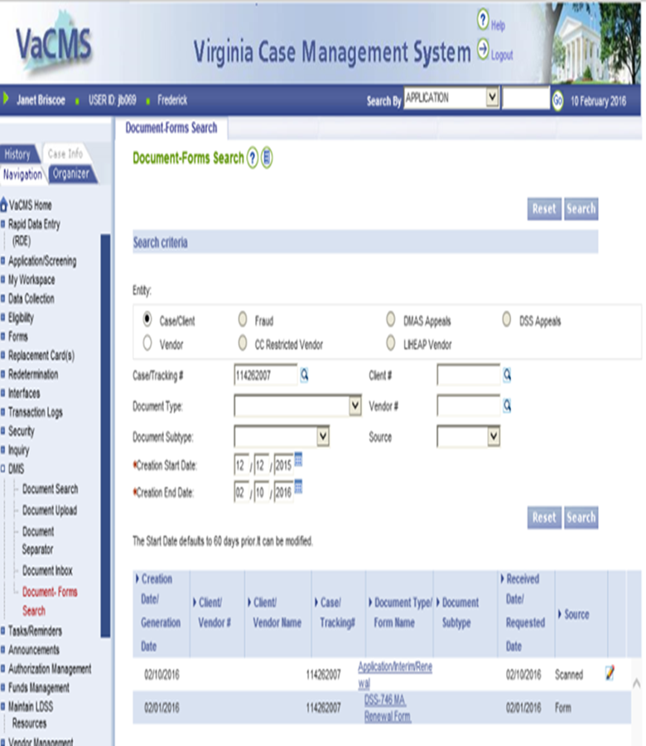
VACMS Search SEARCHES/CHANGES
Click DMIS(on left hand side)
Click Document-Forms Search*(left hand side)
  This will allow you to search the following types of documents:
    Forms that are generate by VaCMS
    Scanned in items by staff
    Uploaded /Scanned in items by client
Enter Case/Tracking # or client ID number in appropriate place
        You shouldn’t haven’t change the creation start and end date if looking for current 6 months, but will have to change if previously than that
        Click search button
  In search can tell you how document was put in:
    Scanned= DMIS State Scanner (perceptive content)
    VACMS= Uploaded directly into VACMS
    Commonhelp= Client uploaded document self

Slide 13
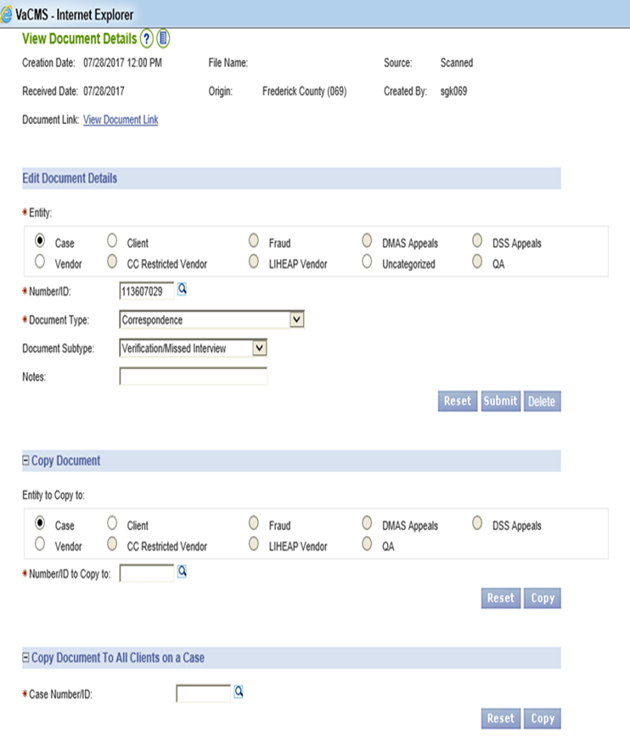

VACMS SEARCHES / CHANGES
Search for the document like previous slide instructions.
Once documents come up below, click pencil icon next to document to duplicate scan, change document title, or see notes.
Each section does this:
    Under Edit Document Details section can Switch document name or read/ type a note regarding the document
    Under Copy Document section pick case/client and can, enter case/client ID in box, click Copy button to copy document already scanned to individual clients or different case completely!
    Under Copy Document To All Clients on Case Section enter case number in box and click copy button to copy for all clients on same case.

Slide 14
Questions & DISCUSSIONS
janet.briscoe@fcva.us

