Slide 1
Growing Your Knowledge with LASER
Christopher (Chris) Powell – Eastern Regional Administrative Manager

Slide 2
What is brown and sticky?
A Stick!

Slide 3
About me
Hampton DSS 1999 - 2002
Williamsburg DSS 2002 -2022
Commonwealth of VA 2022 - ???

Slide 4
Locality Automated System Expenditure Reimbursement
Notes:
Locality Automated System Expenditure Reimbursement

Slide 5
Where to start?

Slide 6
Portfolios

Slide 7
Welcome to Finance

Slide 8
Local Resources

Slide 9
Month End Schedule

Slide 10
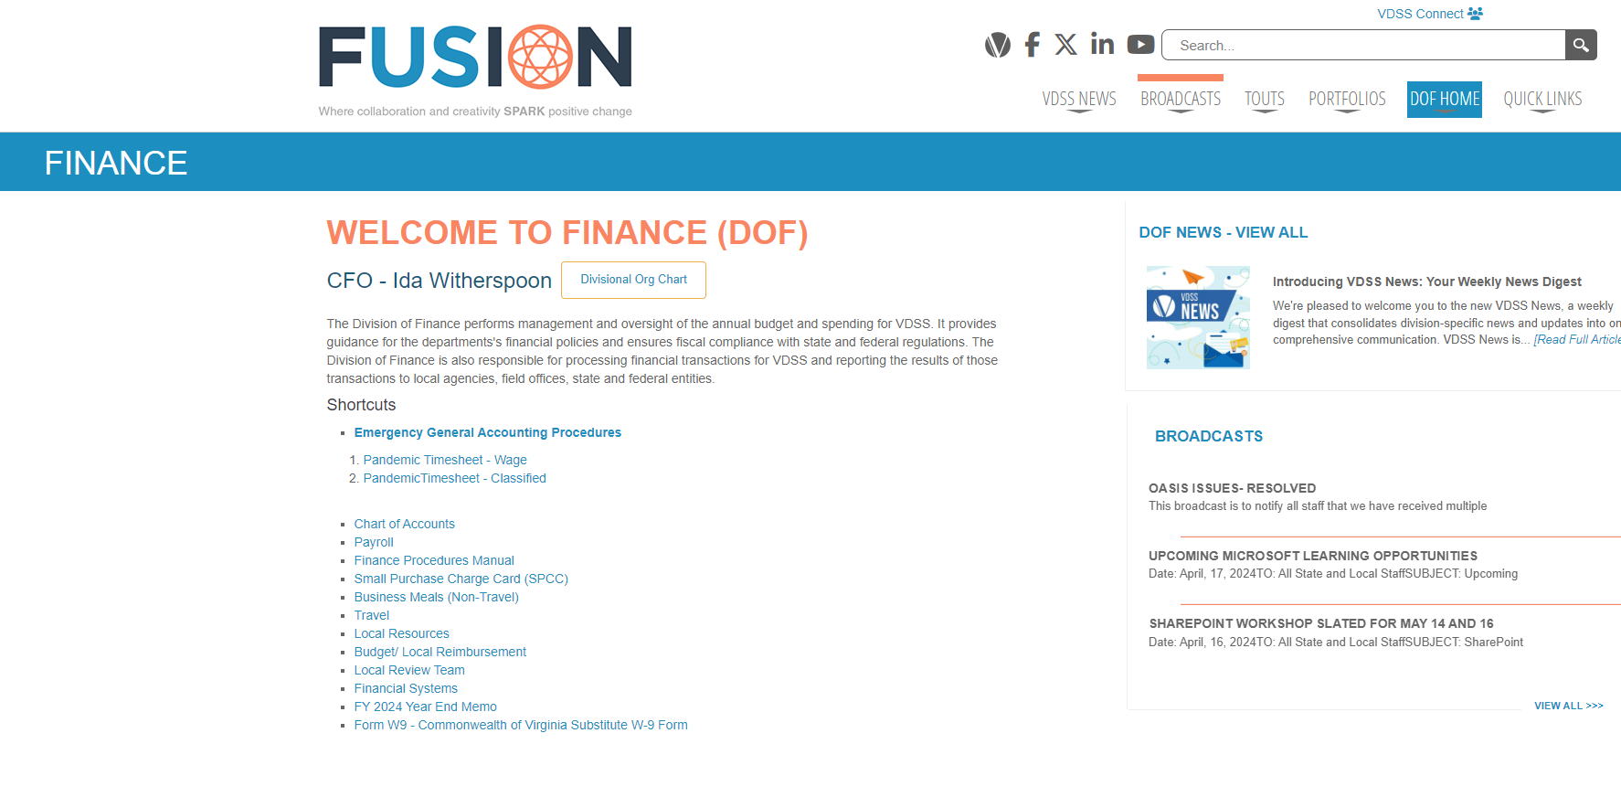
Welcome to Finance

Slide 11
The good stuff

Slide 12
FAQs

Slide 13
FAQ9 Employee Bonuses

Slide 14
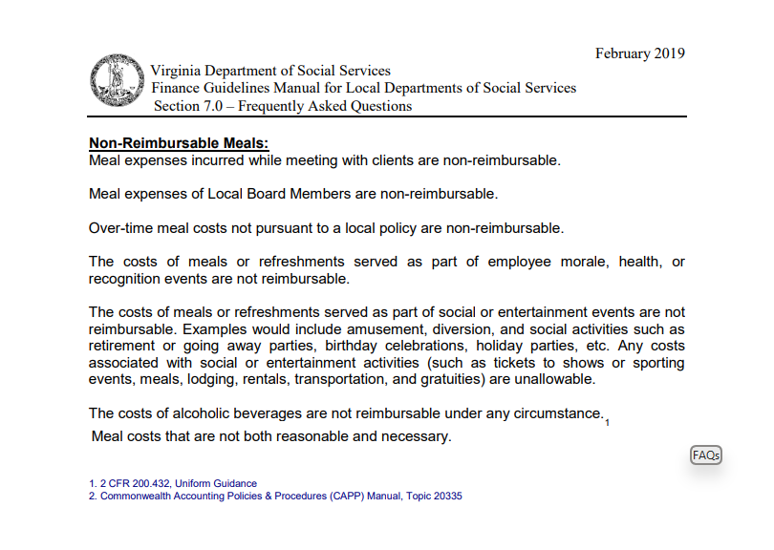
FAQ41 Employee Meals

Slide 15
The good stuff

Slide 16
Finance Guidelines Manual

Slide 17
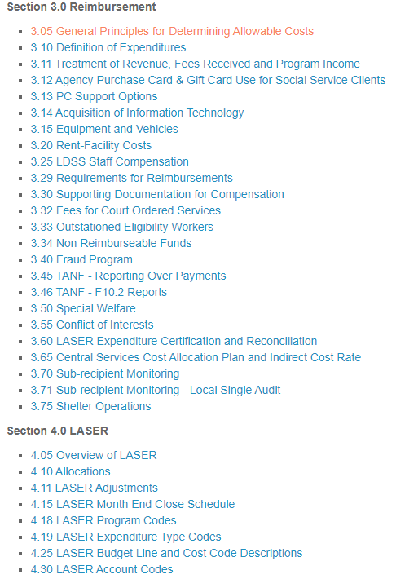
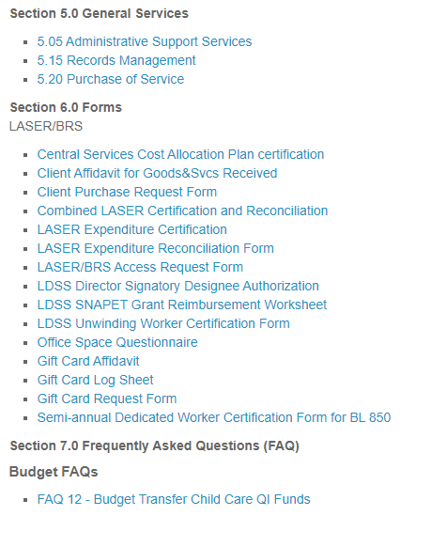
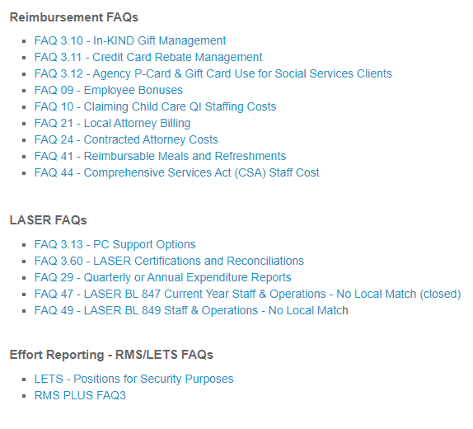
Finance Guidelines Manual Continued

Slide 18
The good stuff

Slide 19
Laser Resource Documents

Slide 20
Summary of Finance Guidelines Manual Updates

Slide 21
Laser Resource Documents

Slide 22
Laser Resource Documents Continued

Slide 23
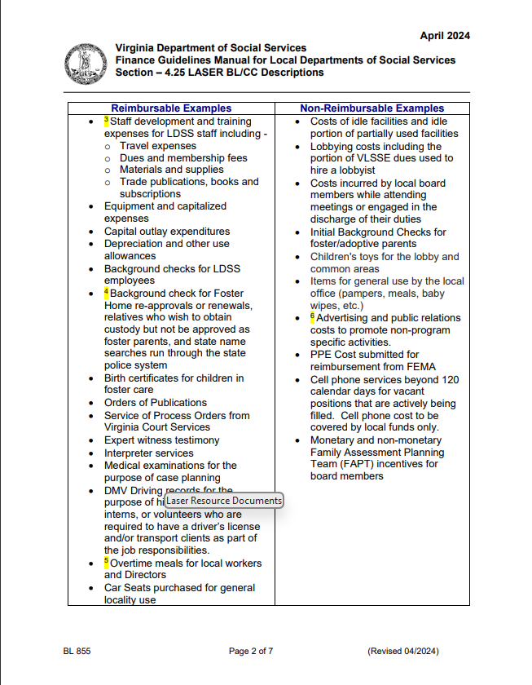
855 Staff & Operations Base Budget

Slide 24
The good stuff

Slide 25
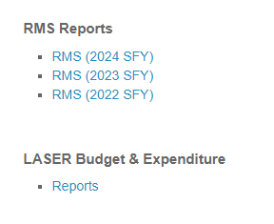
Reports

Slide 26
LASER Budget & Expenditure Reports

Slide 27
LASER Agency Budget Balance Report YTD

Slide 28
The good stuff

Slide 29
Training
This includes how to delete a batch, and reserving funds!

Slide 30
Reserving Funds
* DO THIS PROCESS BEFORE THE JOURNALS ARE POSTED

Slide 31
Reserving Funds Continued

Slide 32
Funds Reserved

Slide 33
The good stuff

Slide 34
LASER/Local Reimbursement

Slide 35
LASER/Local Reimbursement Continued

Slide 36
The good stuff

Slide 37
Travel

Slide 39
Chris Powell christopher1.powell@dss.virginia.gov Find me on teams chat!
Thank you for attending!

