Slide 1
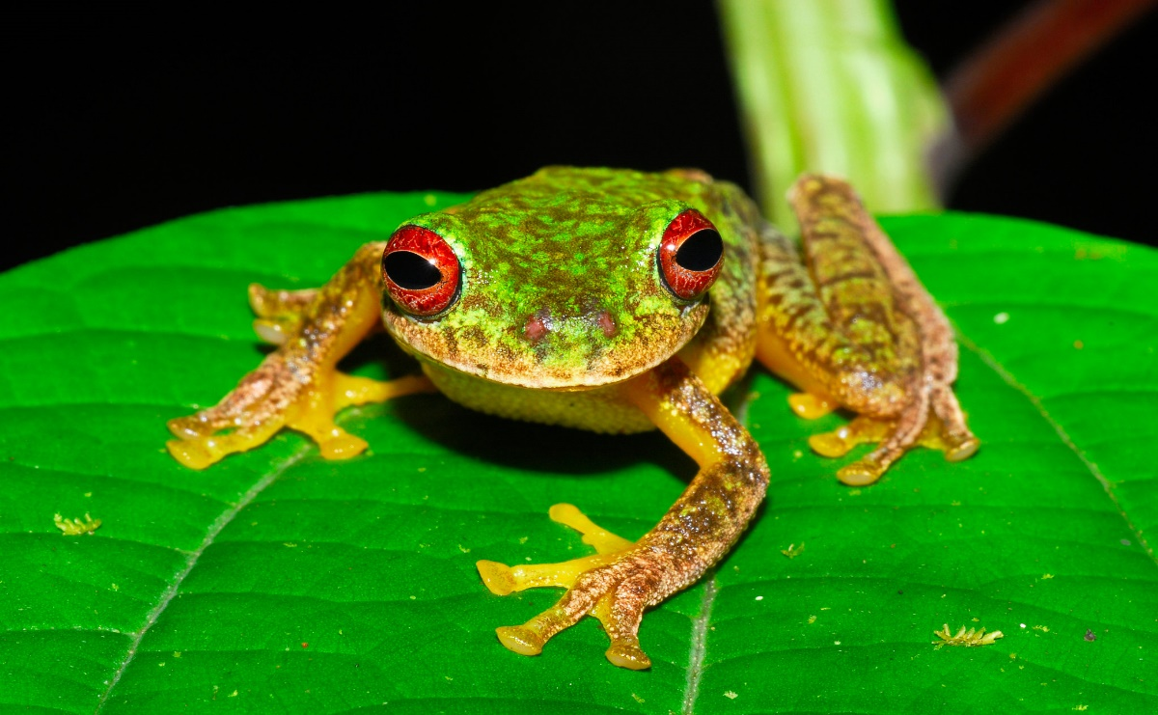
Eat the Frog Making Minutes Matter
Tamara Temoney-Porter, PhD
Director, Hampton Department of Human Services

Slide 2
“If the first thing you do each morning is to eat a live frog, you can go through the day with the satisfaction of knowing that is probably the worst thing that is going to happen to you all day long.”
-- Mark Twain

Slide 3
Eat the Frog
Rule 1
If you have to eat two frogs, eat the ugliest one first
If you have two tasks that need to be completed, start with the hardest one first
Tracy,B.(2001). Eat That Frog. Berrett-Koehler Publishers, Inc.
Rule 2
If you have to eat a live frog at all it doesn’t pay to sit and look at it for very long
Do not procrastinate and wait until the last minute to complete a task

Slide 4
How do I prioritize my frogs?
There will never be enough time in the day to do everything you need to do
If a task or activity has large potential consequences, it should be a top priority
(i.e. Establishing a process to ensure phone calls are returned timely)
If a task can have large potential negative consequences if it is not done quickly, it should be a top priority
(i.e. Responding to a customer that has contacted the Director or your supervisor)

Slide 5
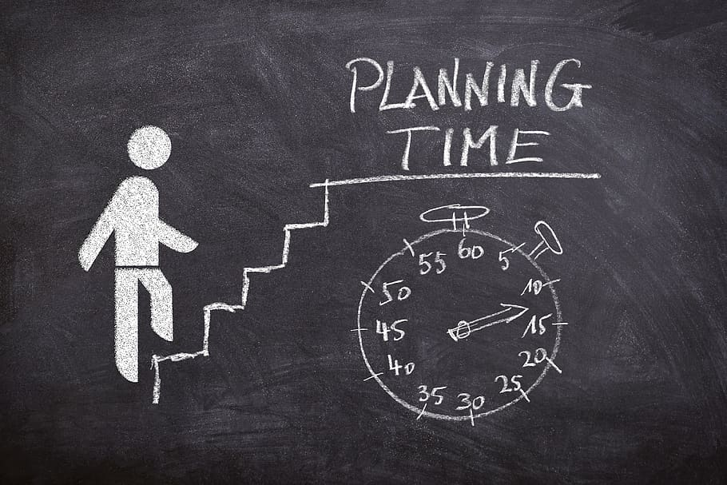
The Importance of Planning
10% worth of planning, can save you 90% of time- Tracey, B.
Develop to-do lists to help keep track of what needs to be completed. Lists should be daily, weekly, monthly, and annually.
Establish realistic deadlines and include time to accommodate for the unexpected. Working under pressure creates more stress and increases the potential for mistakes.
Establish goals and objectives for what you are hoping to accomplish. Identify who else needs to be involved to complete the task and include allowances for their scheduling challenges.

Slide 7
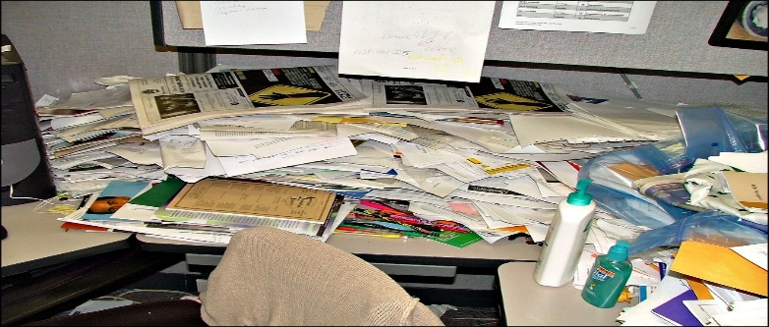
Reasons for Distractions at Work According to a survey by UC-Irvine, the average office worker is interrupted every 11 minutes and it takes an average of 25 minutes to return to the original task
1. Noise
2. Phones and electronic devices
3. Multi-tasking
4. Interruptions (Colleagues, staff)
5. Clutter

Slide 8
How Can I Achieve Maximum Productivity?
1. What are the biggest frogs that I have to eat to make the greatest contribution to my agency? (What are my highest value activities?)
2. What can I and only I do that if done well will make a real difference?
3. What is my biggest frog of all at this moment?

Slide 9
Strategies to Minimize Distractions and Increase Productivity
Identify specific times throughout the day to check and respond to email and phone messages
Make a deliberate effort for silence and use protected time when you do not answer the phone or have walk-in office traffic
Schedule “no-meeting” days weekly, bi-weekly or quarterly
Say “no” to things or activities that do not add value to your productivity or help you get the job done

Slide 10
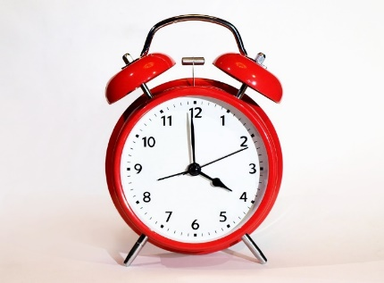
Creative Procrastination
Put off smaller things to accomplish bigger tasks
You will only gain control of your time if you eliminate those activities that do not add value or increase your productivity
Look at work activities to identify tasks that you could delegate or eliminate to free up time
Most people engage in unconscious procrastination, which is putting off the things you do not want to do

Slide 11
Anytime you stop striving to to get better, you are bound to get wor worse. -- Pat Riley -- Identify the most important things you do and make a plan to upgrade your skills in those areas -- You can learn whatever skills you need to be more productive and effective

Slide 12
Quick List Method
Write down your 3 most important goals right now
How are your daily activities helping you achieve these goals?
How are your daily activities hindering you from achieving these goals?

Slide 13
You Are the Difference
You have to make the decision to make changes where you can to take back your time
You feel a sense of accomplishment when you set goals and achieve them.
Identify low-hanging fruit. What are things that you can do differently to be more productive?

Slide 14
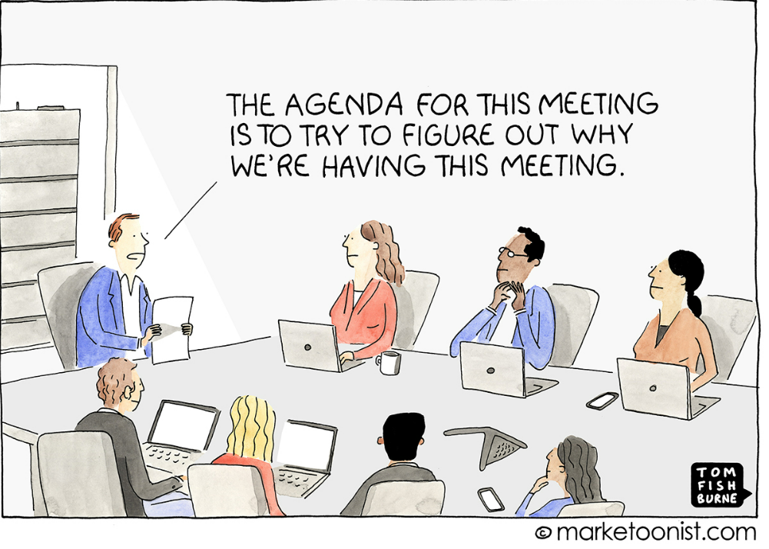
Making Meetings Matter

Slide 15
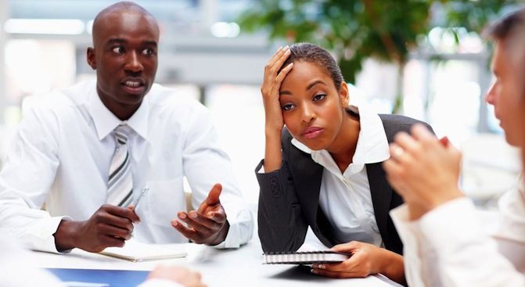
What would you rather do than attend a bad meeting?
1. Go to the dentist
2. Talk politics at family dinner
3. Watch C-Span in a waiting room
4. Call the cable company

Slide 16
What are the biggest meeting taboos?
1. Arriving late
2. Cellphone Use
3. Interrupting
4. No Agenda
5. Eating Food

Slide 17
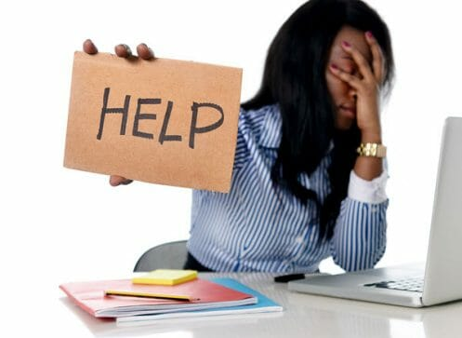
What are the biggest meeting challenges?
1. Off-topic conversations
2.One person dominating
3. Lack of clear next steps
4. Not starting on time
5. Tech/AV Issues

Slide 18
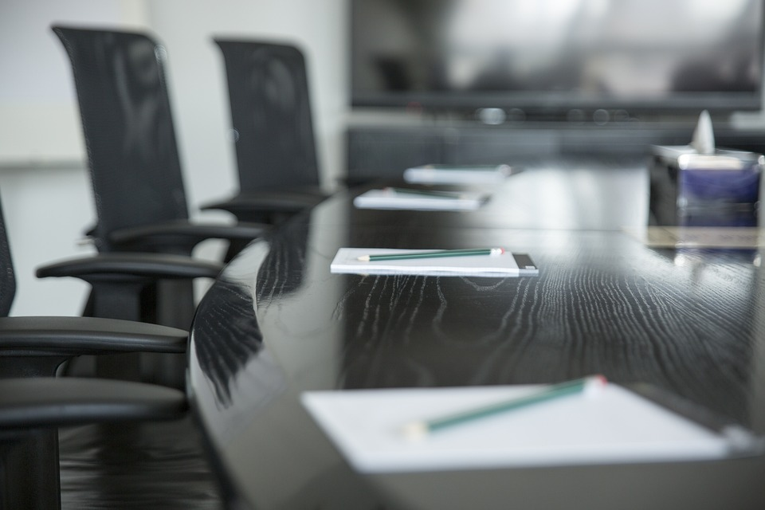
Make Your Meetings Matter
Be clear about the purpose of your meeting
Identify the expected outcome(s) of the meeting
Prepare an agenda and send it to participants before the meeting
Start on time and end on time

Slide 19
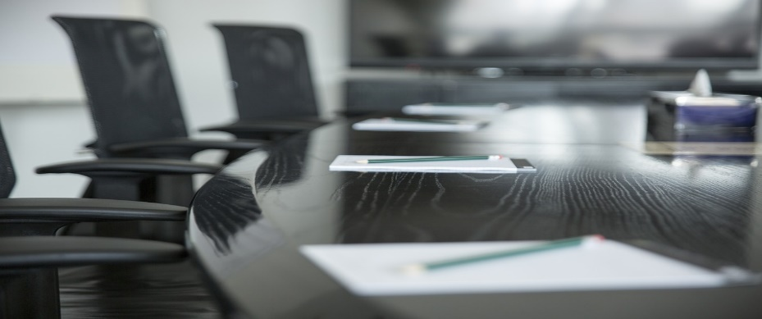
Make Your Meetings Matter
Determine who or what voice is not represented. Should they be invited to the next meeting?
If ground rules are needed, allow meeting participants to establish them at the beginning of the meeting.
(i.e. No cell phones, time limits on same discussion topic, no side conversations)
Create opportunities to get input from a number of meeting participants rather than only a few
Determine if a virtual option would be better

Slide 20
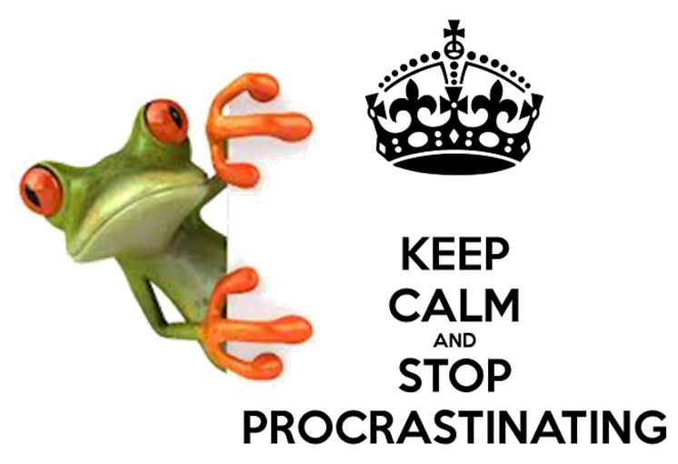

Slide 21
QUESTIONS??

