Slide 1

BPRO POSSESS Security Discussion/QA
Barry Davis
Steve McCauley
4/29/2025
Notes:
Report Phishing

Slide 2
ISRM within VDSS
Notes:
Report Phishing

Slide 3
ISRM within VDSS
Myth:
Information Security is the same as Information Technology, it’s all IT.
Fact:
Information Security deals with security-related issues and it ensures that technology is secure and protected from possible breaches and attacks. Information Technology deals with deploying the technology that will help for the running and growth of a business.

Slide 4
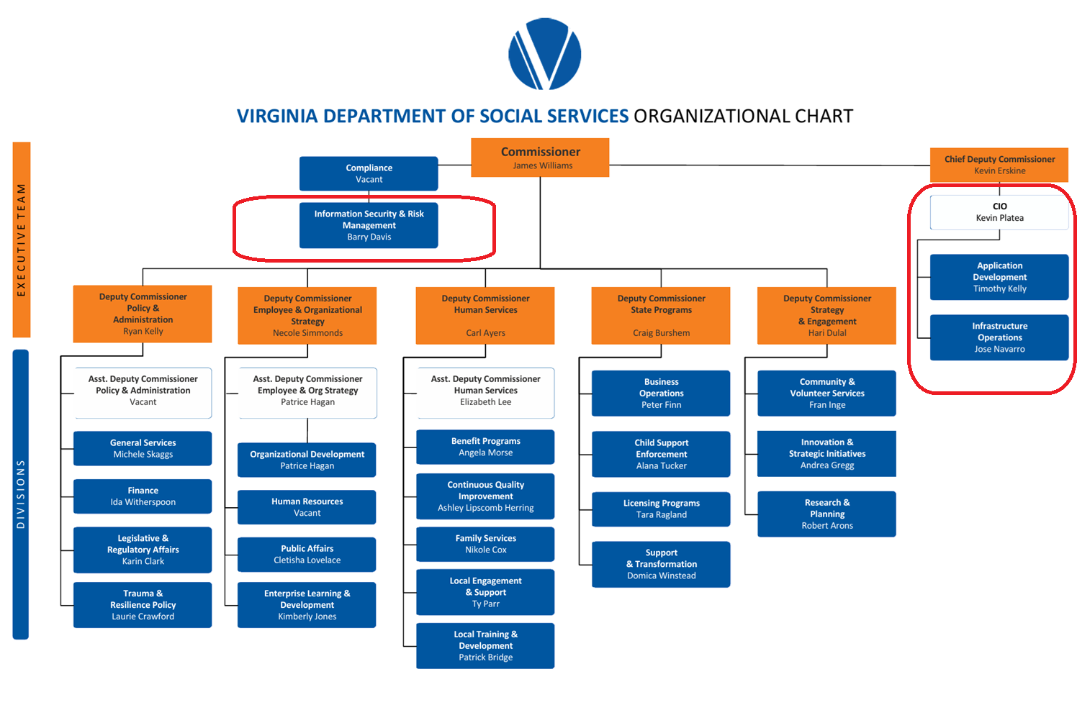
ISRM within VDSS

Slide 5
VDSS Phishing Campaigns
Notes:
Report Phishing

Slide 6
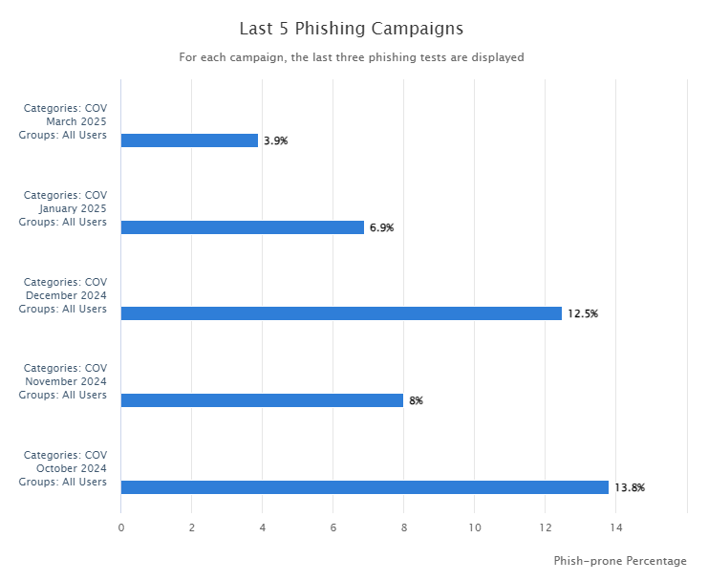
Phishing Campaigns

Slide 7
Reported using the Phish Alert Buttom (PAB)
October – 703
November - 669
December - 796
January - 928
March - 1263

Slide 8
Repeat Customers
371 Users have failed at least 2 out of the last 5 Campaigns
56 Users have failed at least 3 out of the last 5 Campaigns
7 Users have failed at least 4 out of the last 5 Campaigns

Slide 9
Questions
Open to any questions

Slide 10
Report Phishing
Notes:
Report Phishing

Slide 11
Report Phishing Emails with Microsoft 365 Desktop and Web Applications
Purpose
  This job aid is designed to demonstrate how to report phishing emails with the Outlook 365 desktop application and the web version of Outlook 365.
Responsibility
  All Commonwealth of Virginia (COV) users using Outlook 365.
Notes:
Report Phishing Emails with Microsoft 365 Desktop and Web Applications
Purpose
This job aid is designed to demonstrate how to report phishing emails with the Outlook 365 desktop application and the web version of Outlook 365.
Responsibility
All Commonwealth of Virginia (COV) users using Outlook 365.

Slide 12
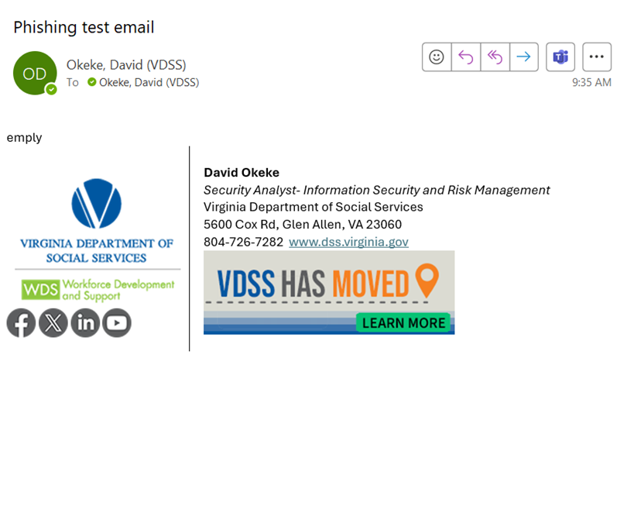
Procedures
Report Phishing Emails with the Outlook desktop application
Select the email that you suspect to be Phishing or Spam
Notes:
Procedures
Report Phishing Emails with the Outlook desktop application
Select the email that you expect to be phishing

Slide 13
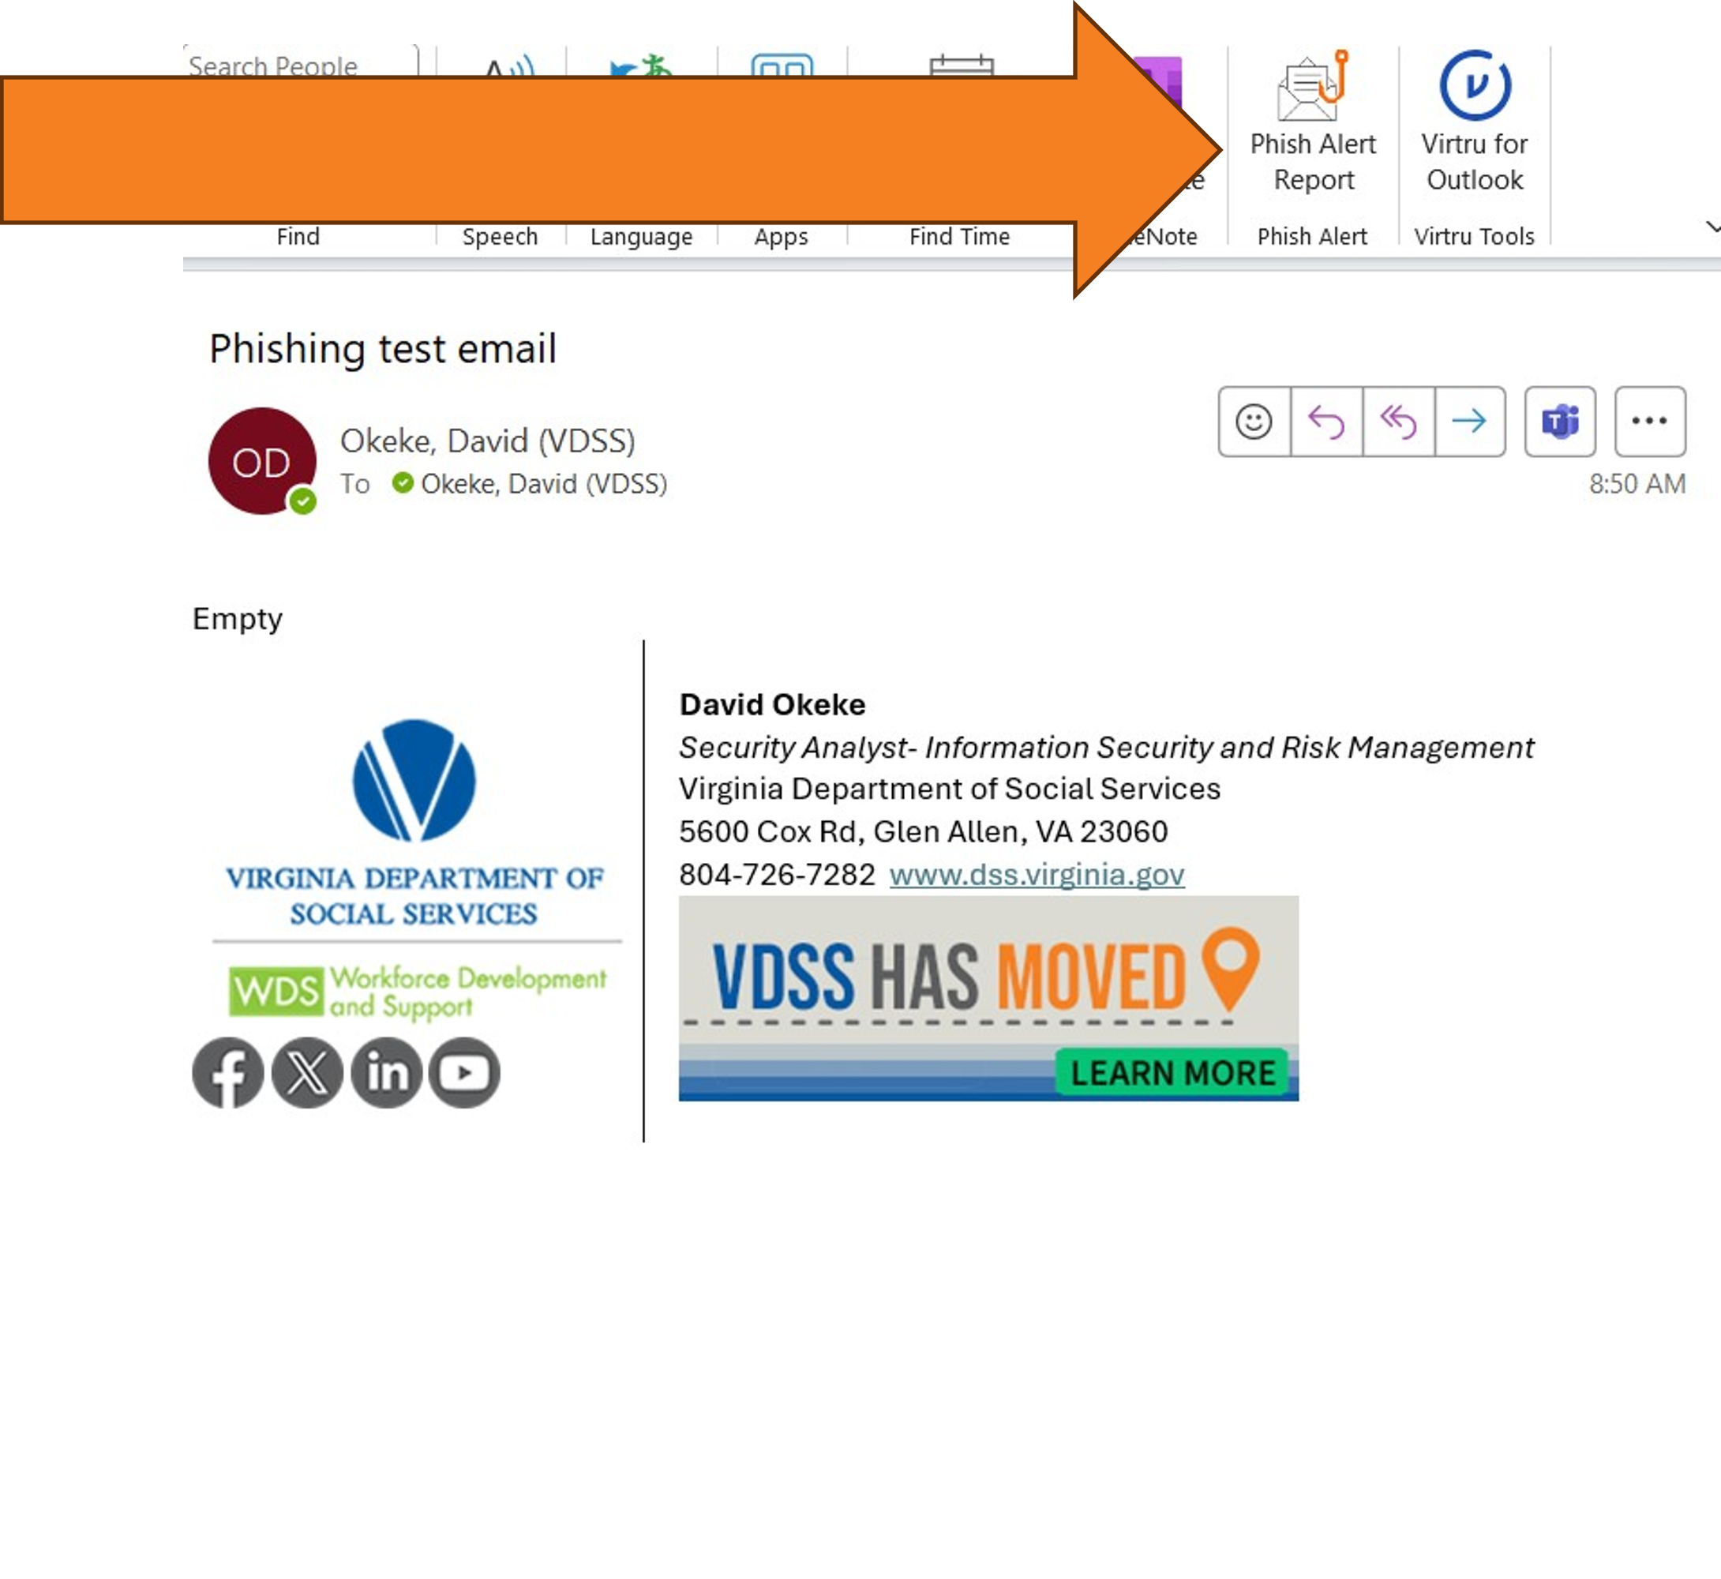
Procedures
Report Phishing Emails with the Outlook desktop application
On the Ribbon, select the Phish Alert Report button
Notes:
Procedures
Report Phishing Emails with the Outlook desktop application
On top of the screen you will see the phishing report button

Slide 14
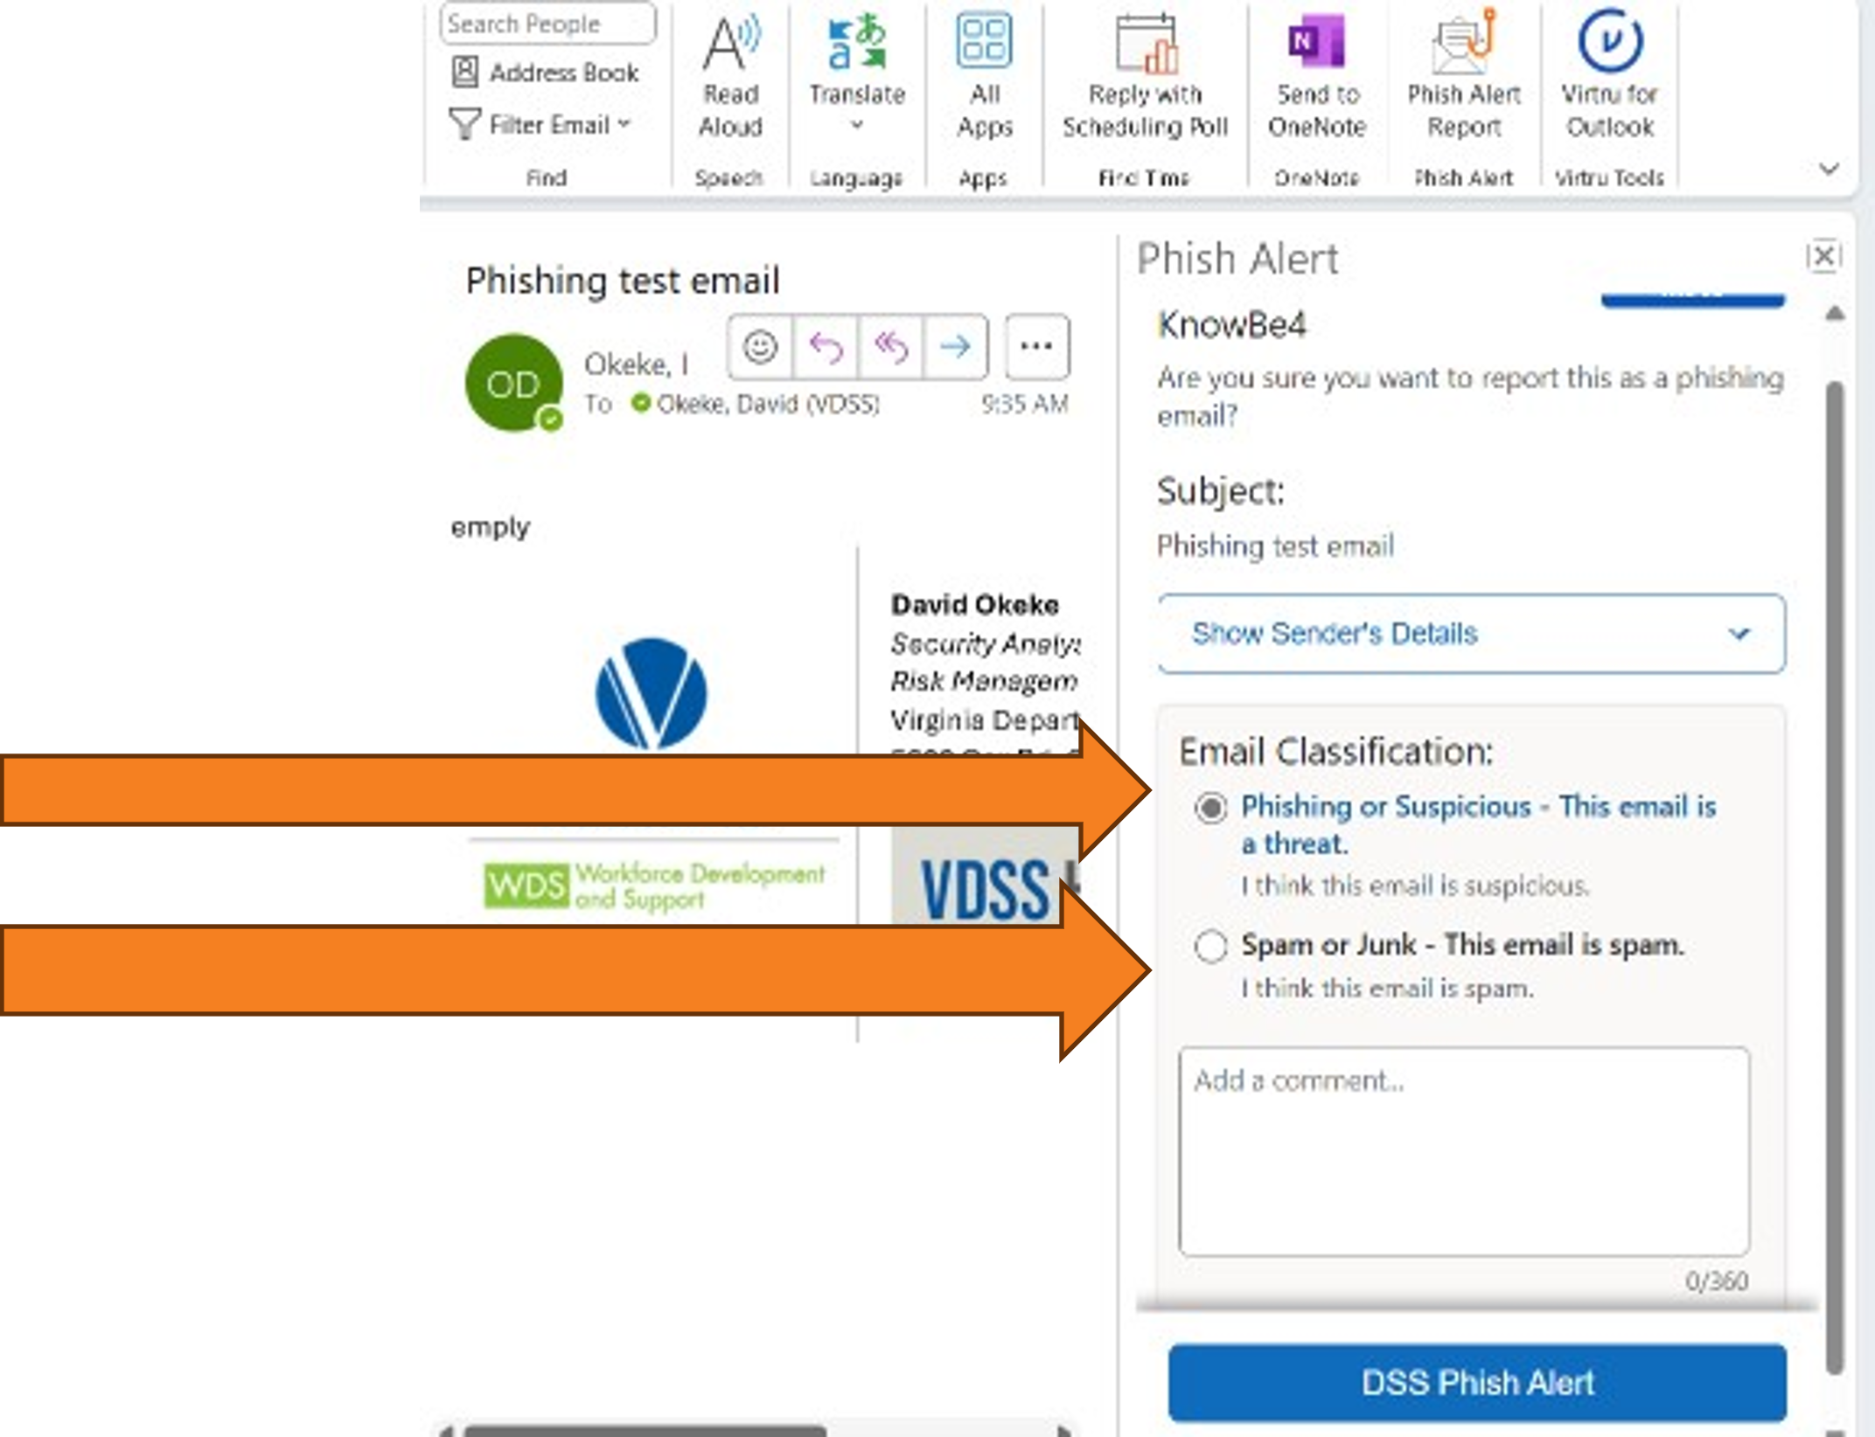
Procedures
Report Phishing Emails with the Outlook desktop application
Select
Phishing or Suspicious
or
Spam or Junk.
Notes:
Procedures
Report Phishing Emails with the Outlook desktop application
Select the Phishing button and choose whether this is phishing/Suspicious or Spam/Junk.

Slide 15
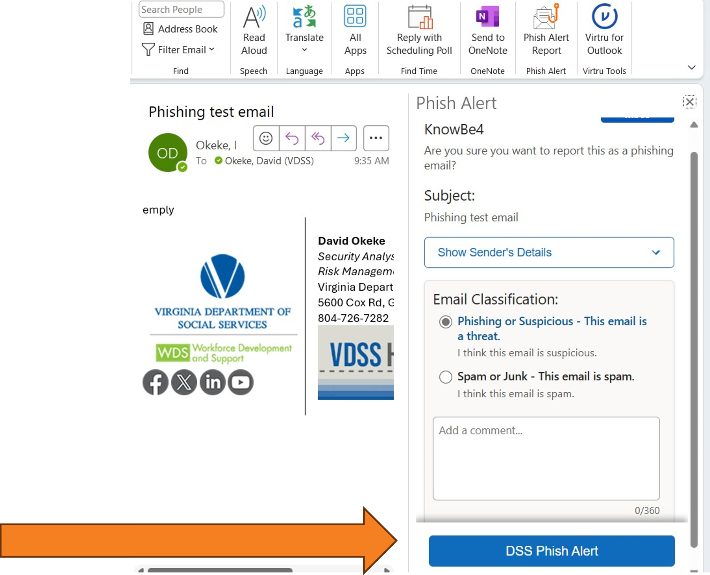
Procedures
Report Phishing Emails with the Outlook desktop application
Select
DSS Phish Alert
Notes:
Procedures
Report Phishing Emails with the Outlook desktop application

Slide 16
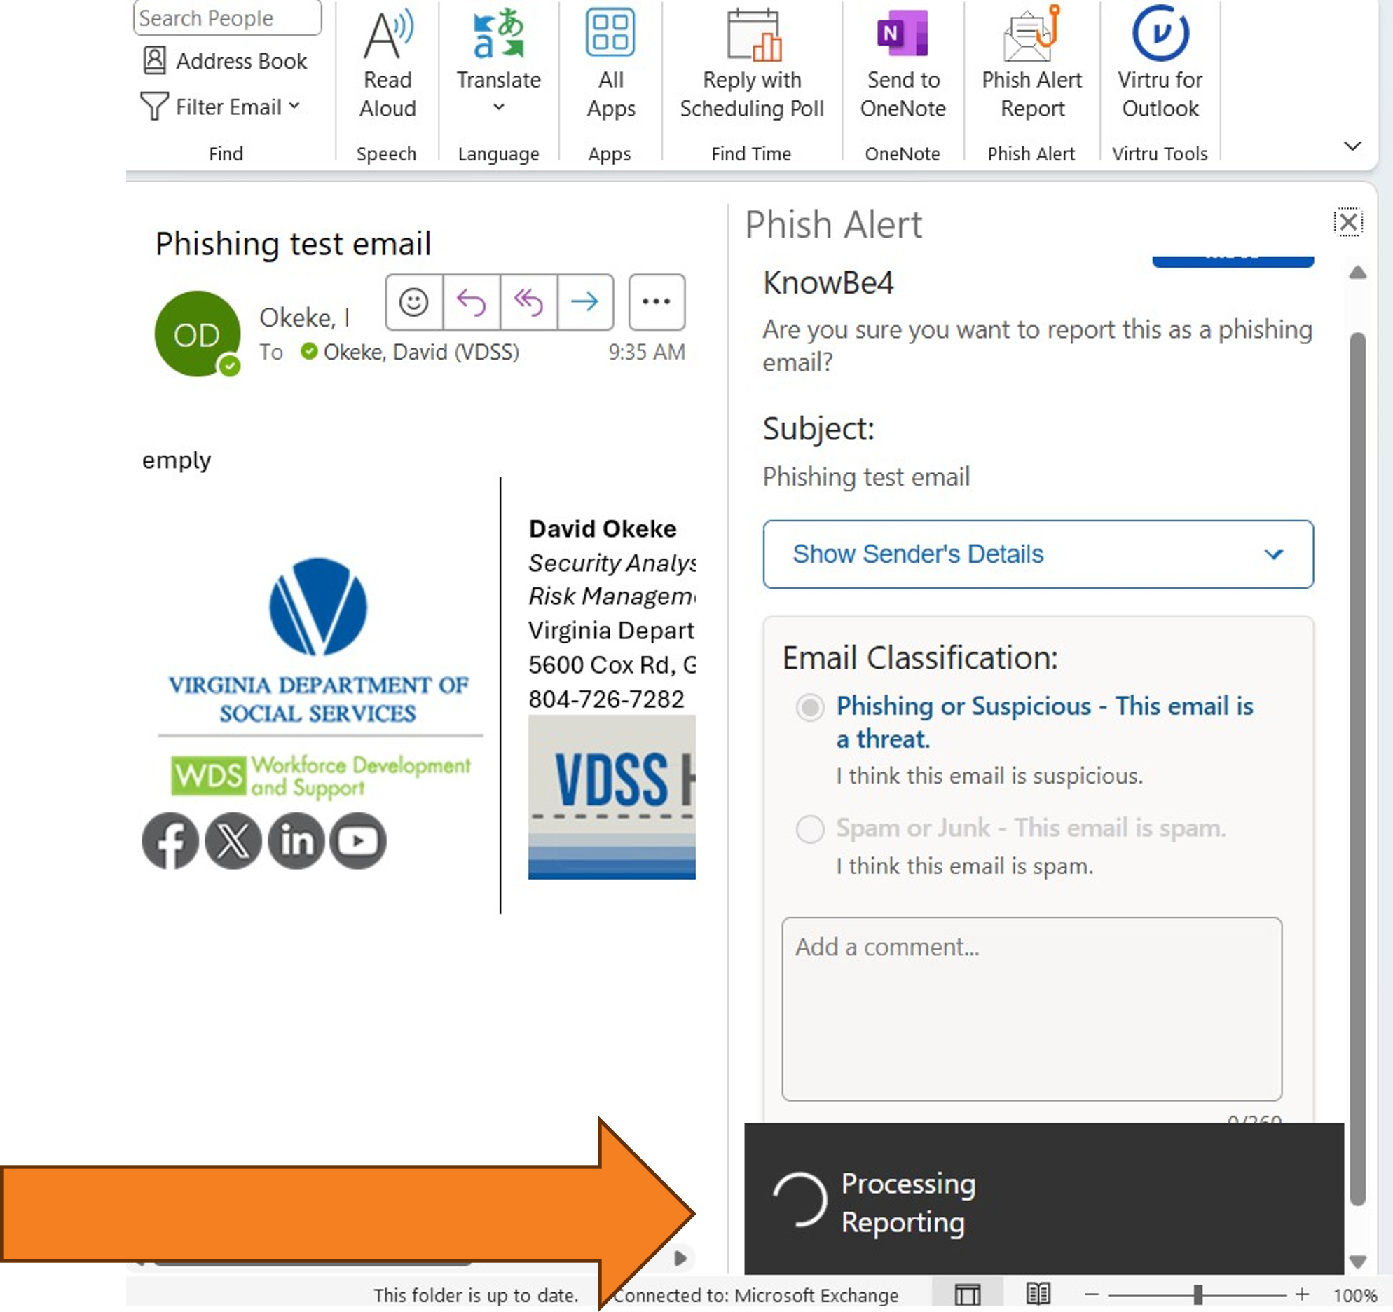
Procedures
Report Phishing Emails with the Outlook desktop application
Once the DSS Phish Alert button has been selected, you may see the Processing Reporting message
Notes:
Once the DSS Phish Alert has been selected, you may see the Processing Reporting message

Slide 17
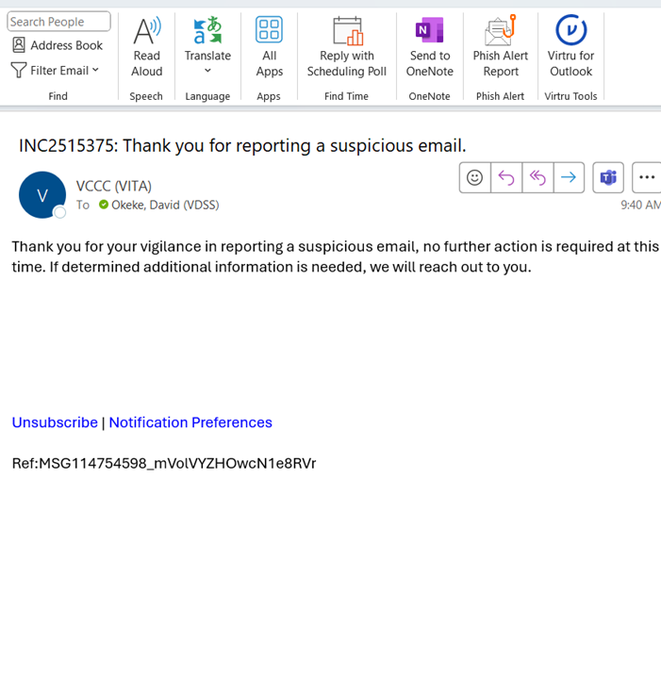
Procedures
Report Phishing Emails with the Outlook desktop application
Once completed, you should receive an email like this
Notes:
Procedures
Report Phishing Emails with the Outlook desktop application
Once completed, the worker should then receive this email

Slide 18
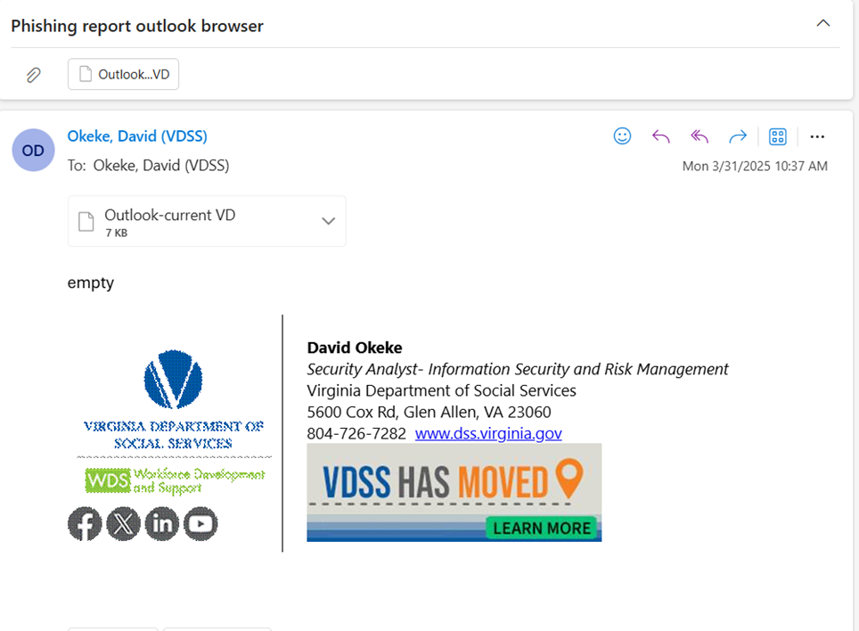
Procedures
Report Phishing Emails with the Outlook through Browser
Select the email that you suspect to be Phishing or Spam
Notes:
Procedures
Report Phishing Emails with the Outlook through Browser
Select the email that you expect to be phishing

Slide 19
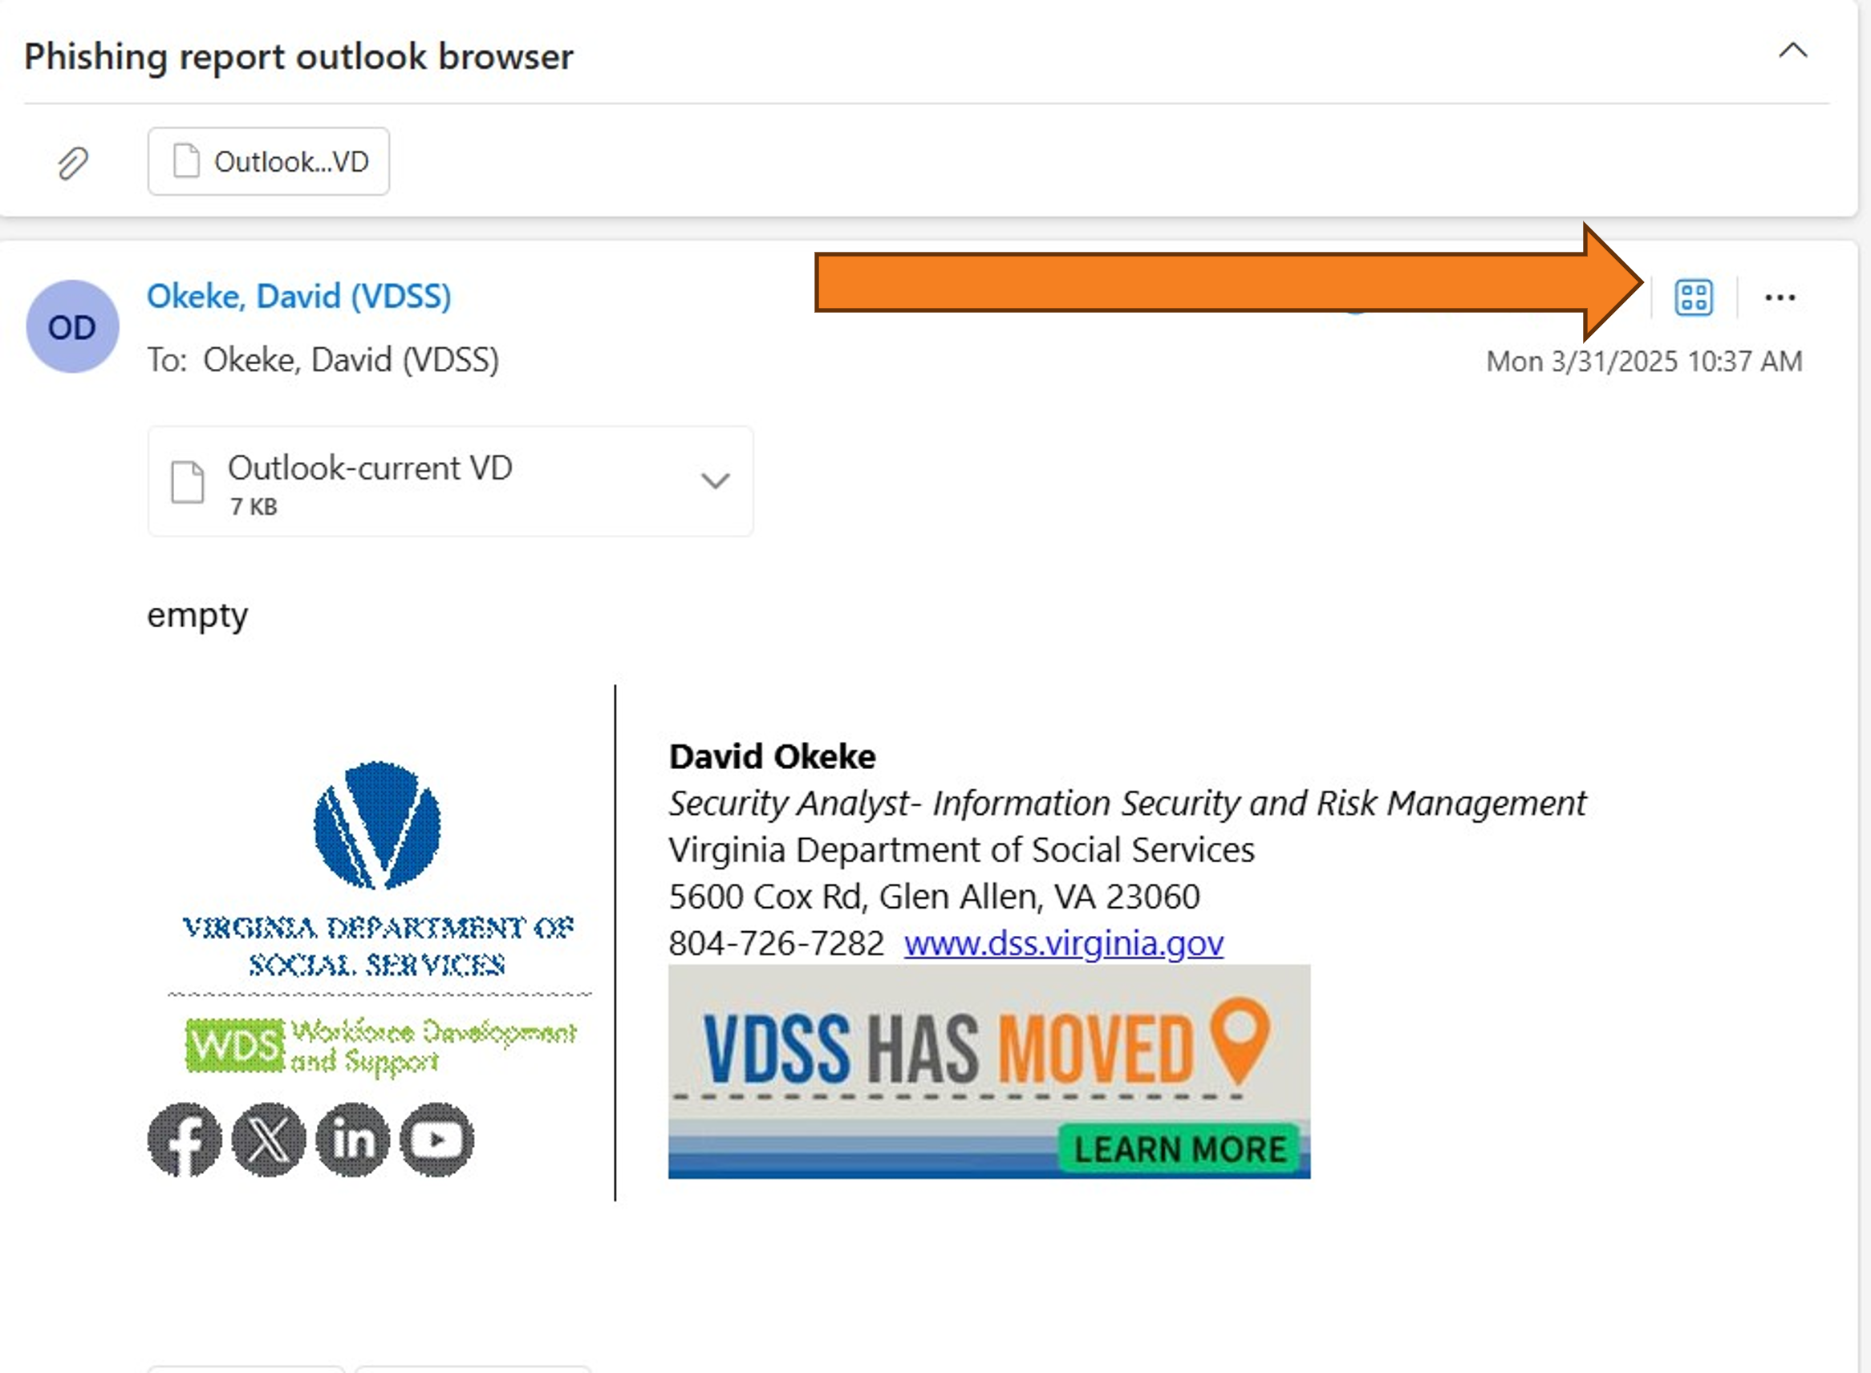
Procedures
Report Phishing Emails with the Outlook through Browser
You will then click on the four-dot app button within the email.
You may also see the
Phish Alert Report button
In the menu.
Notes:
Procedures
Report Phishing Emails with the Outlook through Browser
You will then click on the four-dot app button that is within the email.

Slide 20
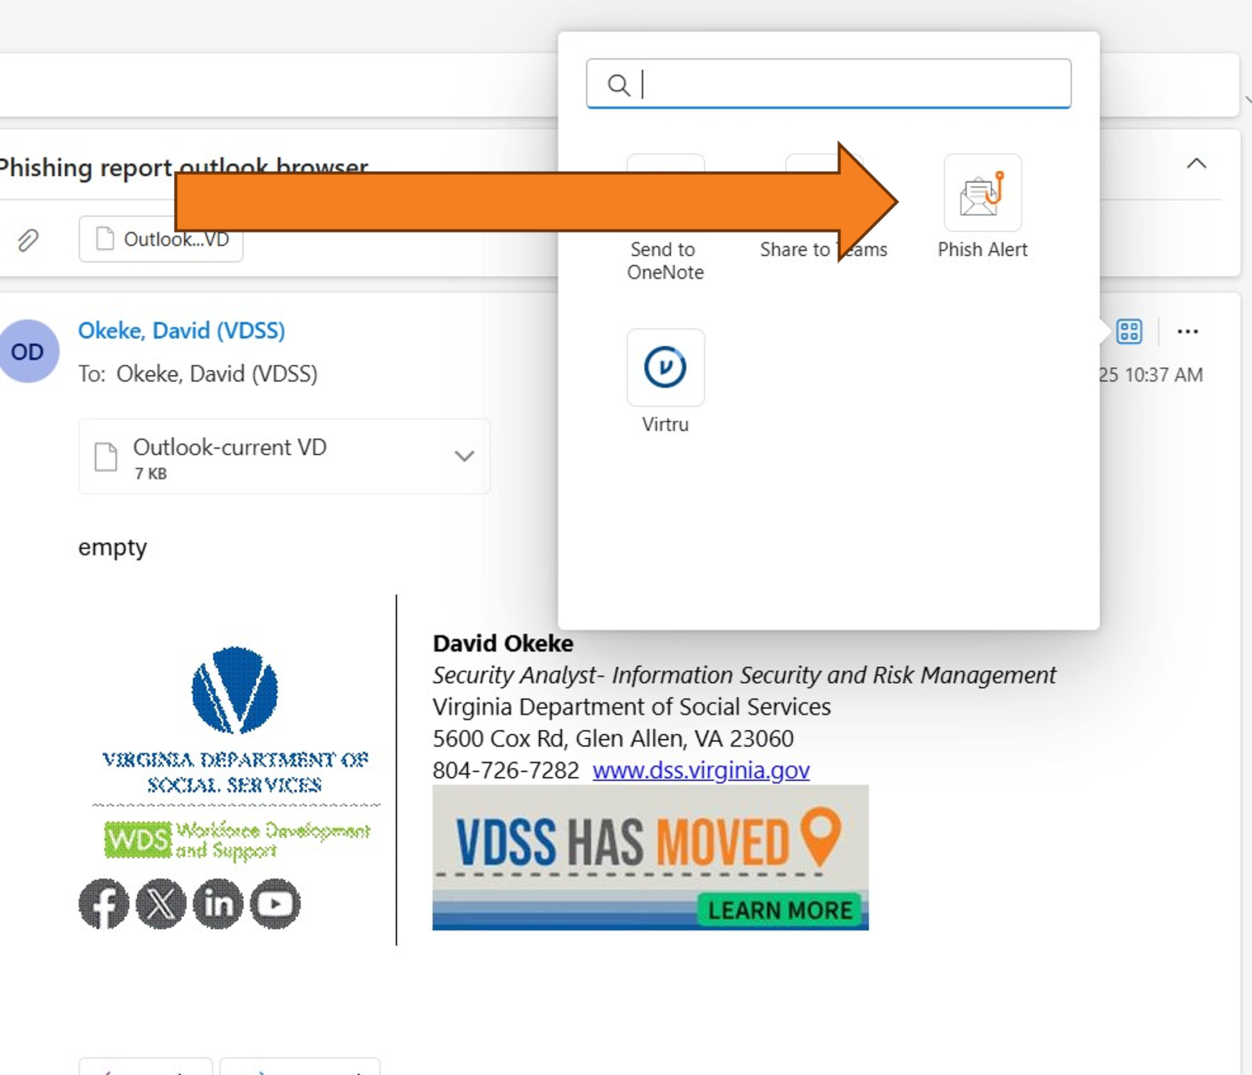
Procedures
Report Phishing Emails with the Outlook through Browser
Select the “Phish Alert” button
Notes:
Procedures
Report Phishing Emails with the Outlook through Browser
Then click on “Phish Alert”

Slide 21
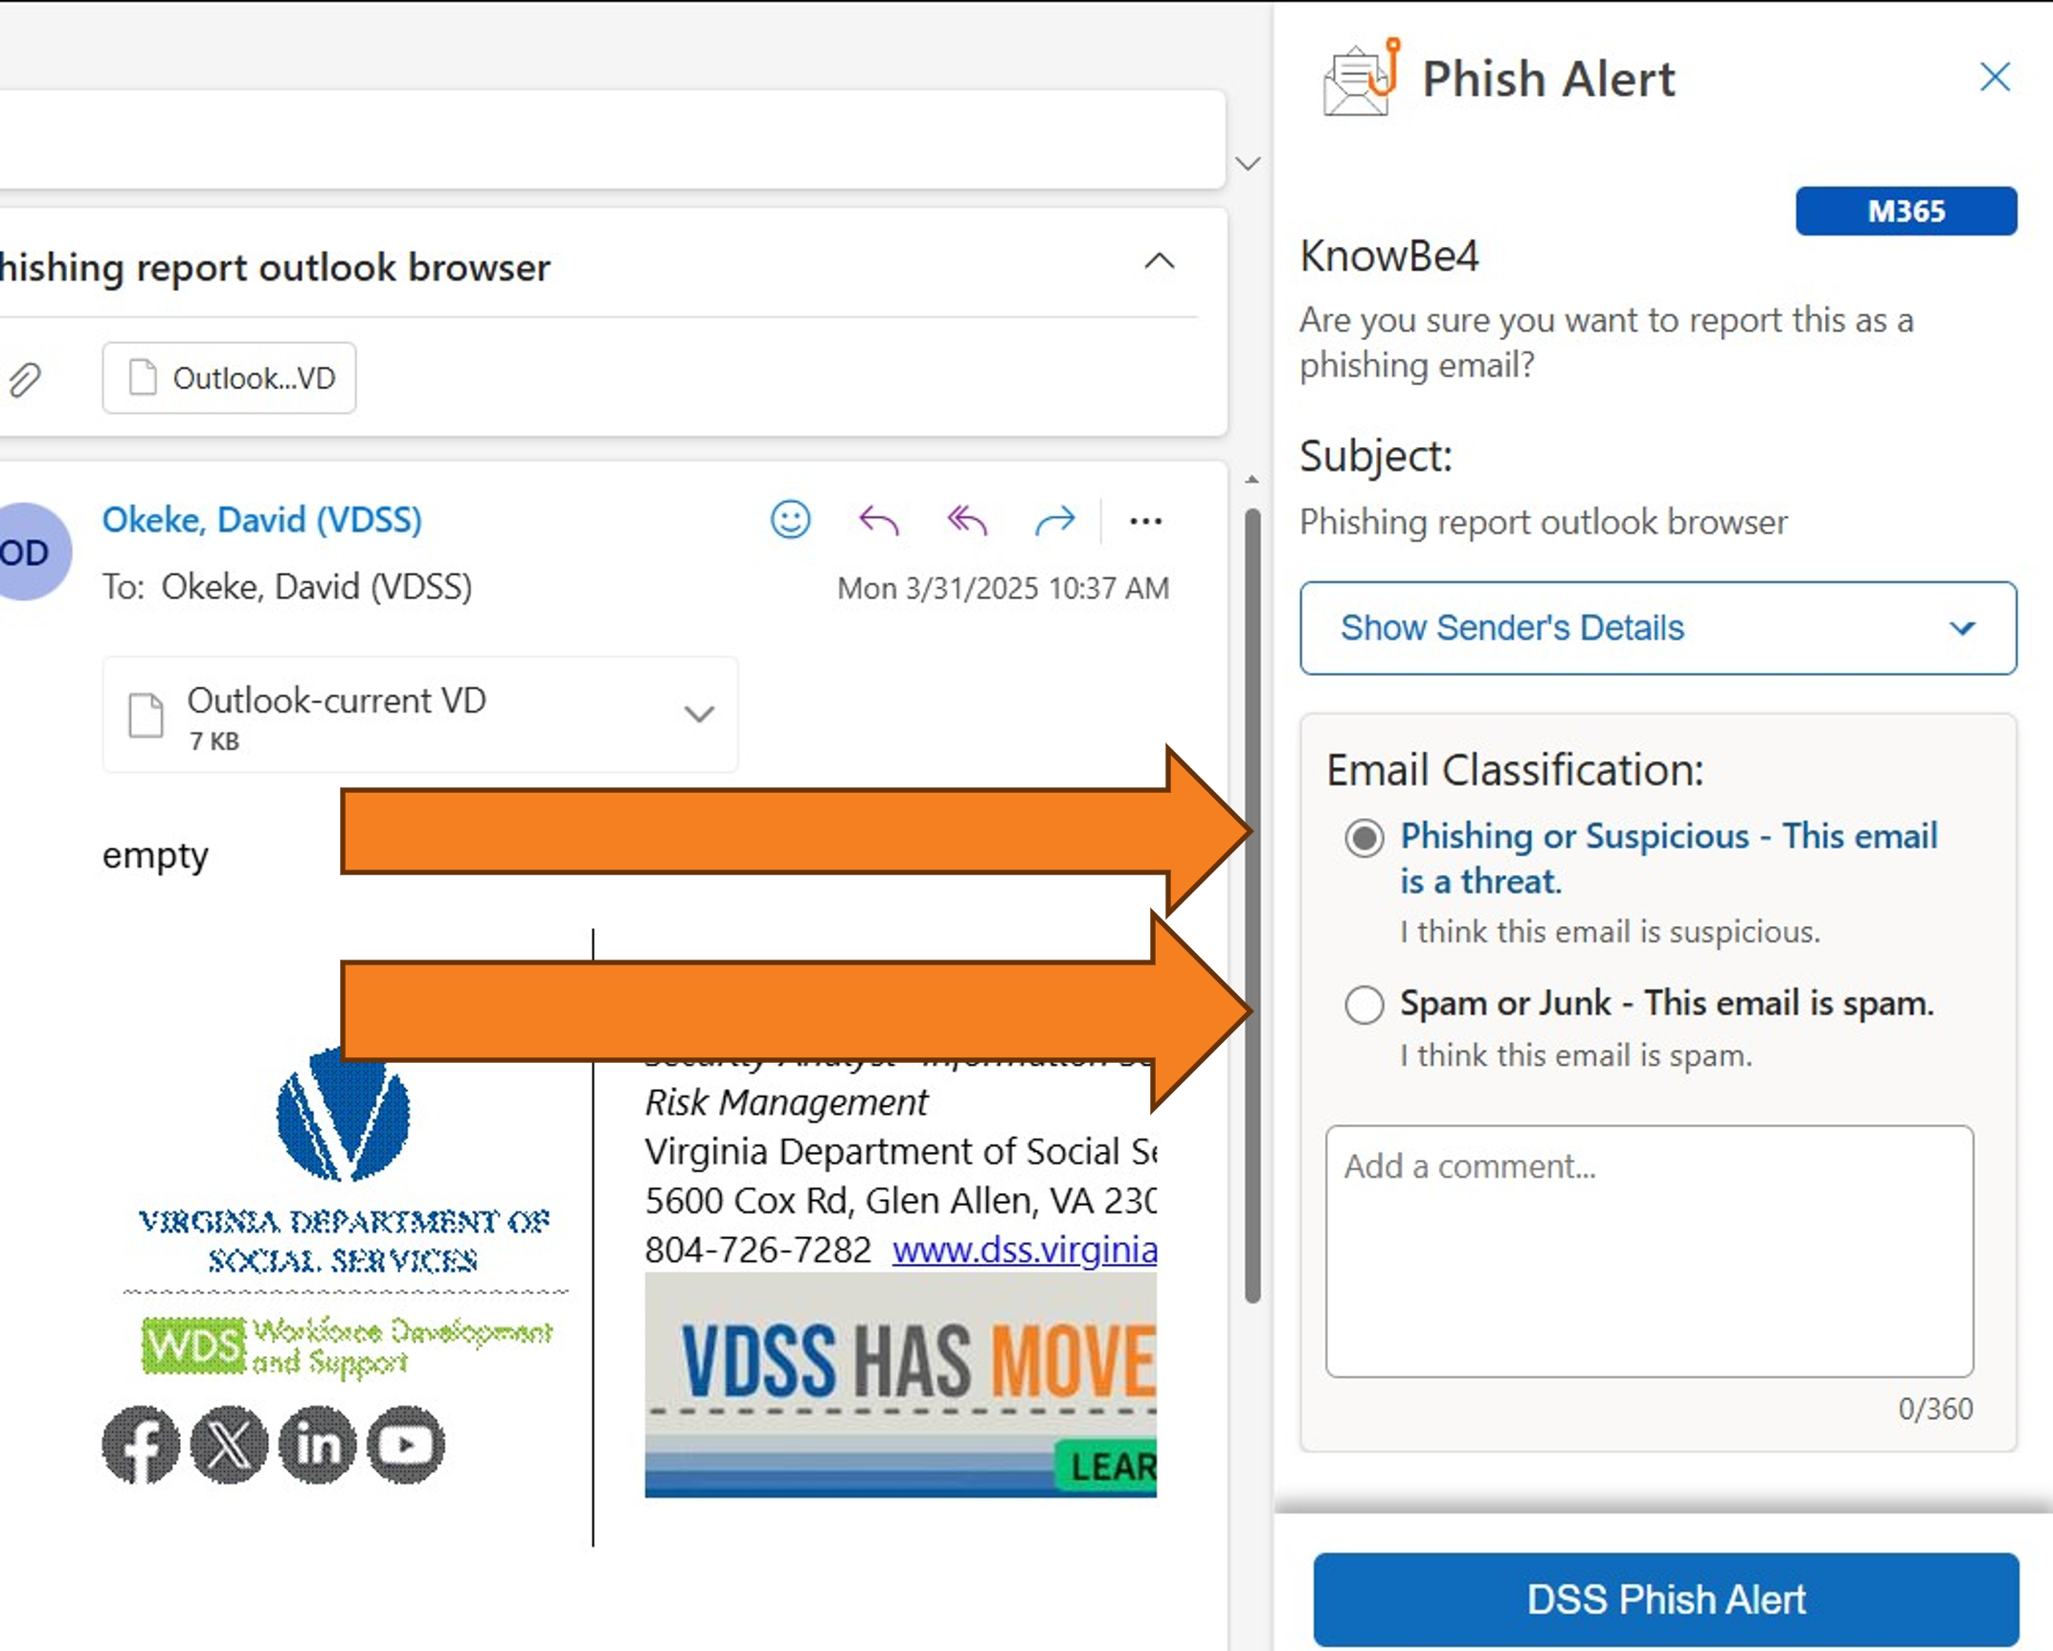
Procedures
Report Phishing Emails with the Outlook through Browser
Select
Phishing or Suspicious
or
Spam or Junk.
Notes:
Procedures
Report Phishing Emails with the Outlook through Browser
Select the Phishing button and choose whether this is phishing/Suspicious or Spam/Junk.

Slide 22
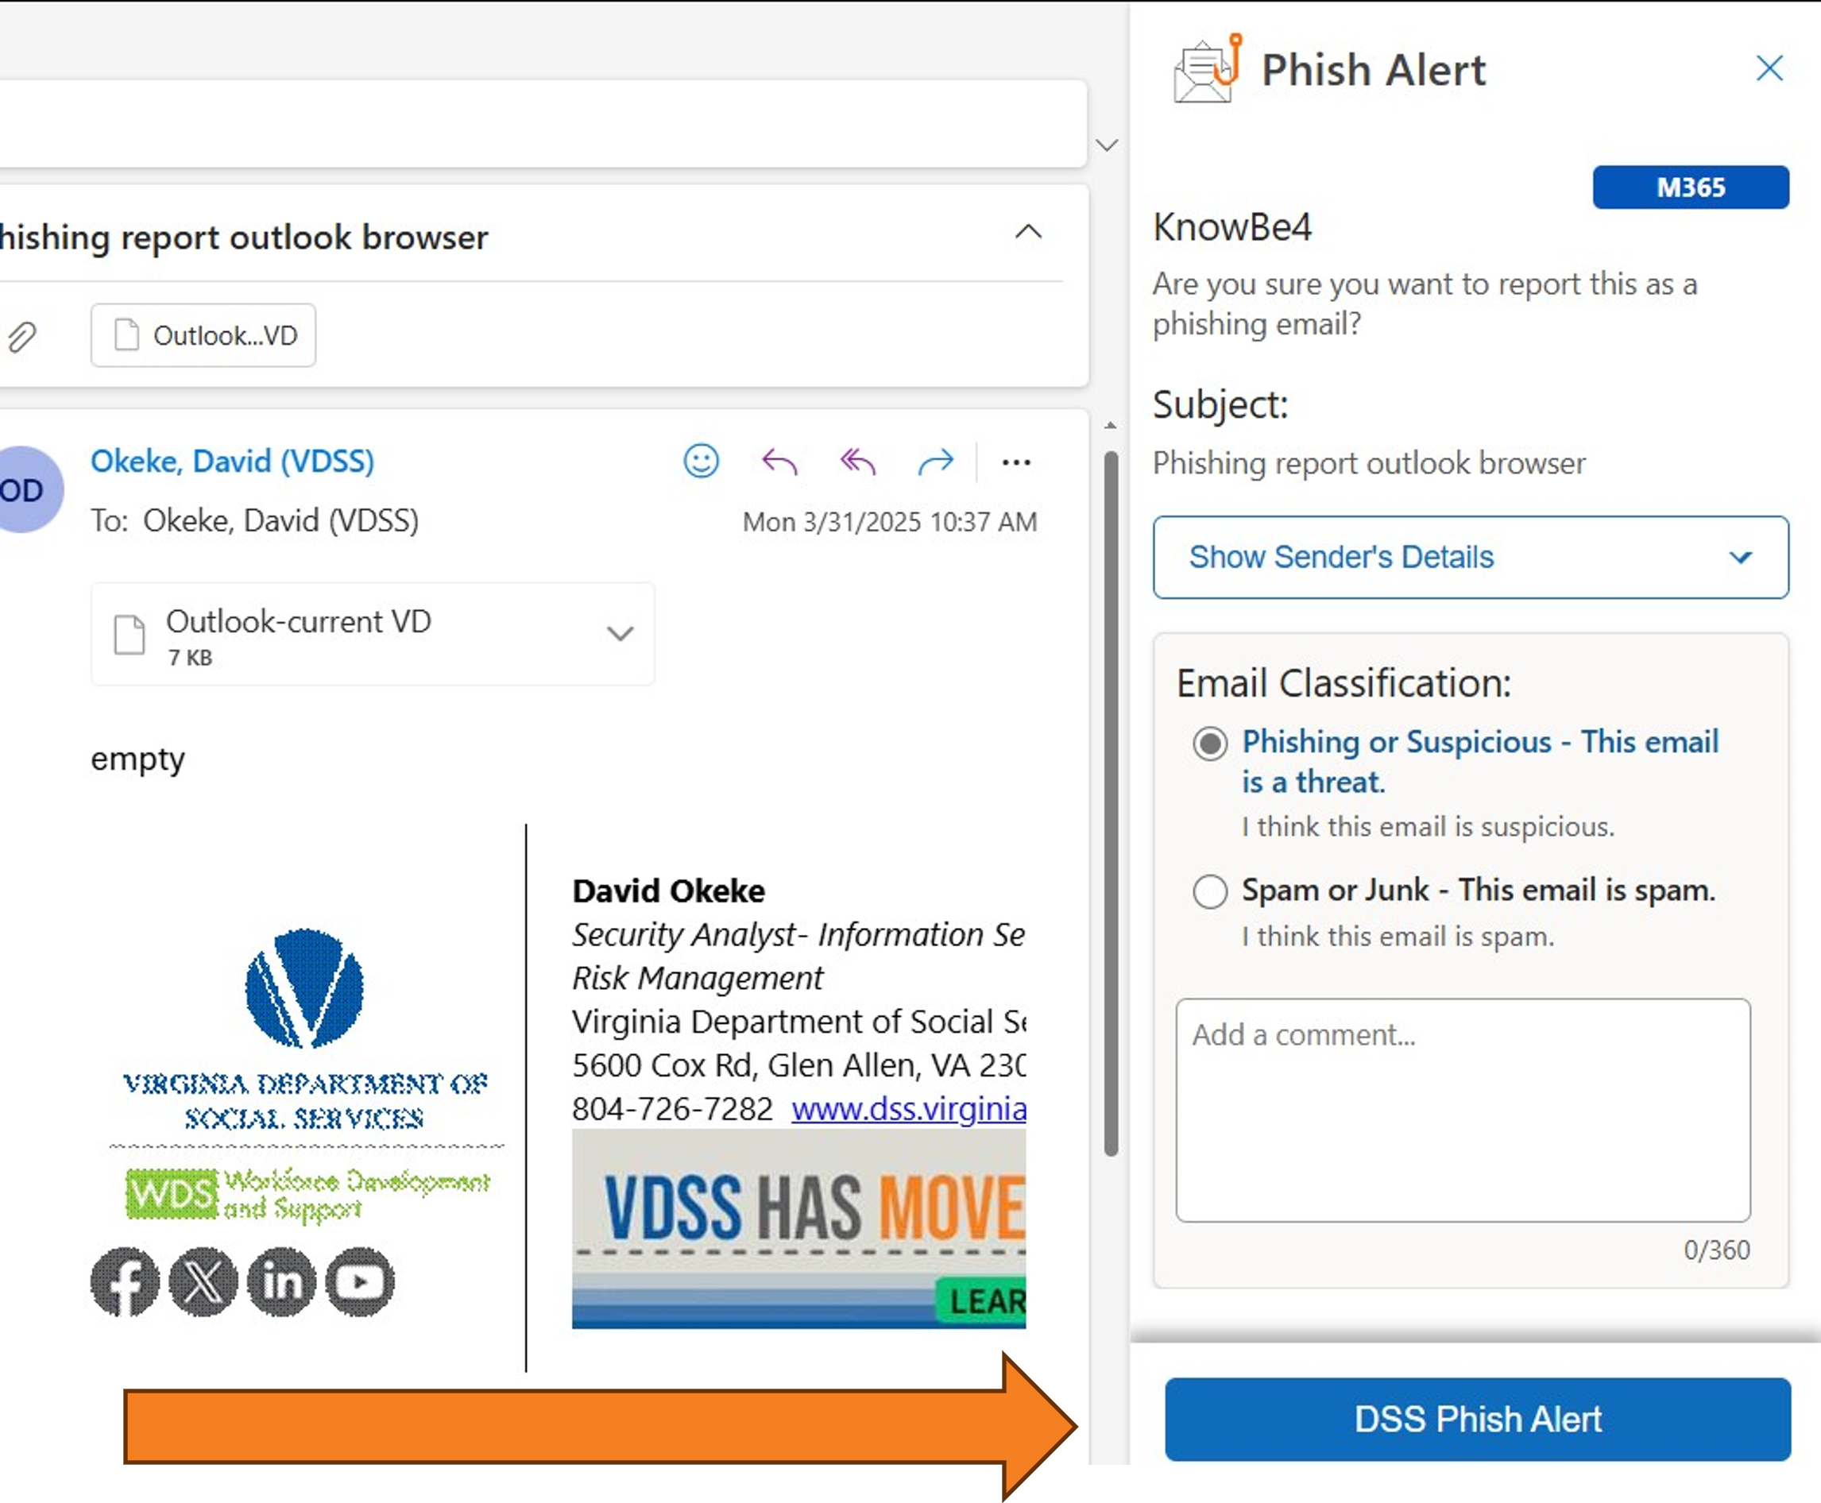
Procedures
Report Phishing Emails with the Outlook through Browser
Select
DSS Phish Alert
Select
DSS Phish Alert
Notes:
Procedures
Report Phishing Emails with the Outlook through Browser

Slide 23
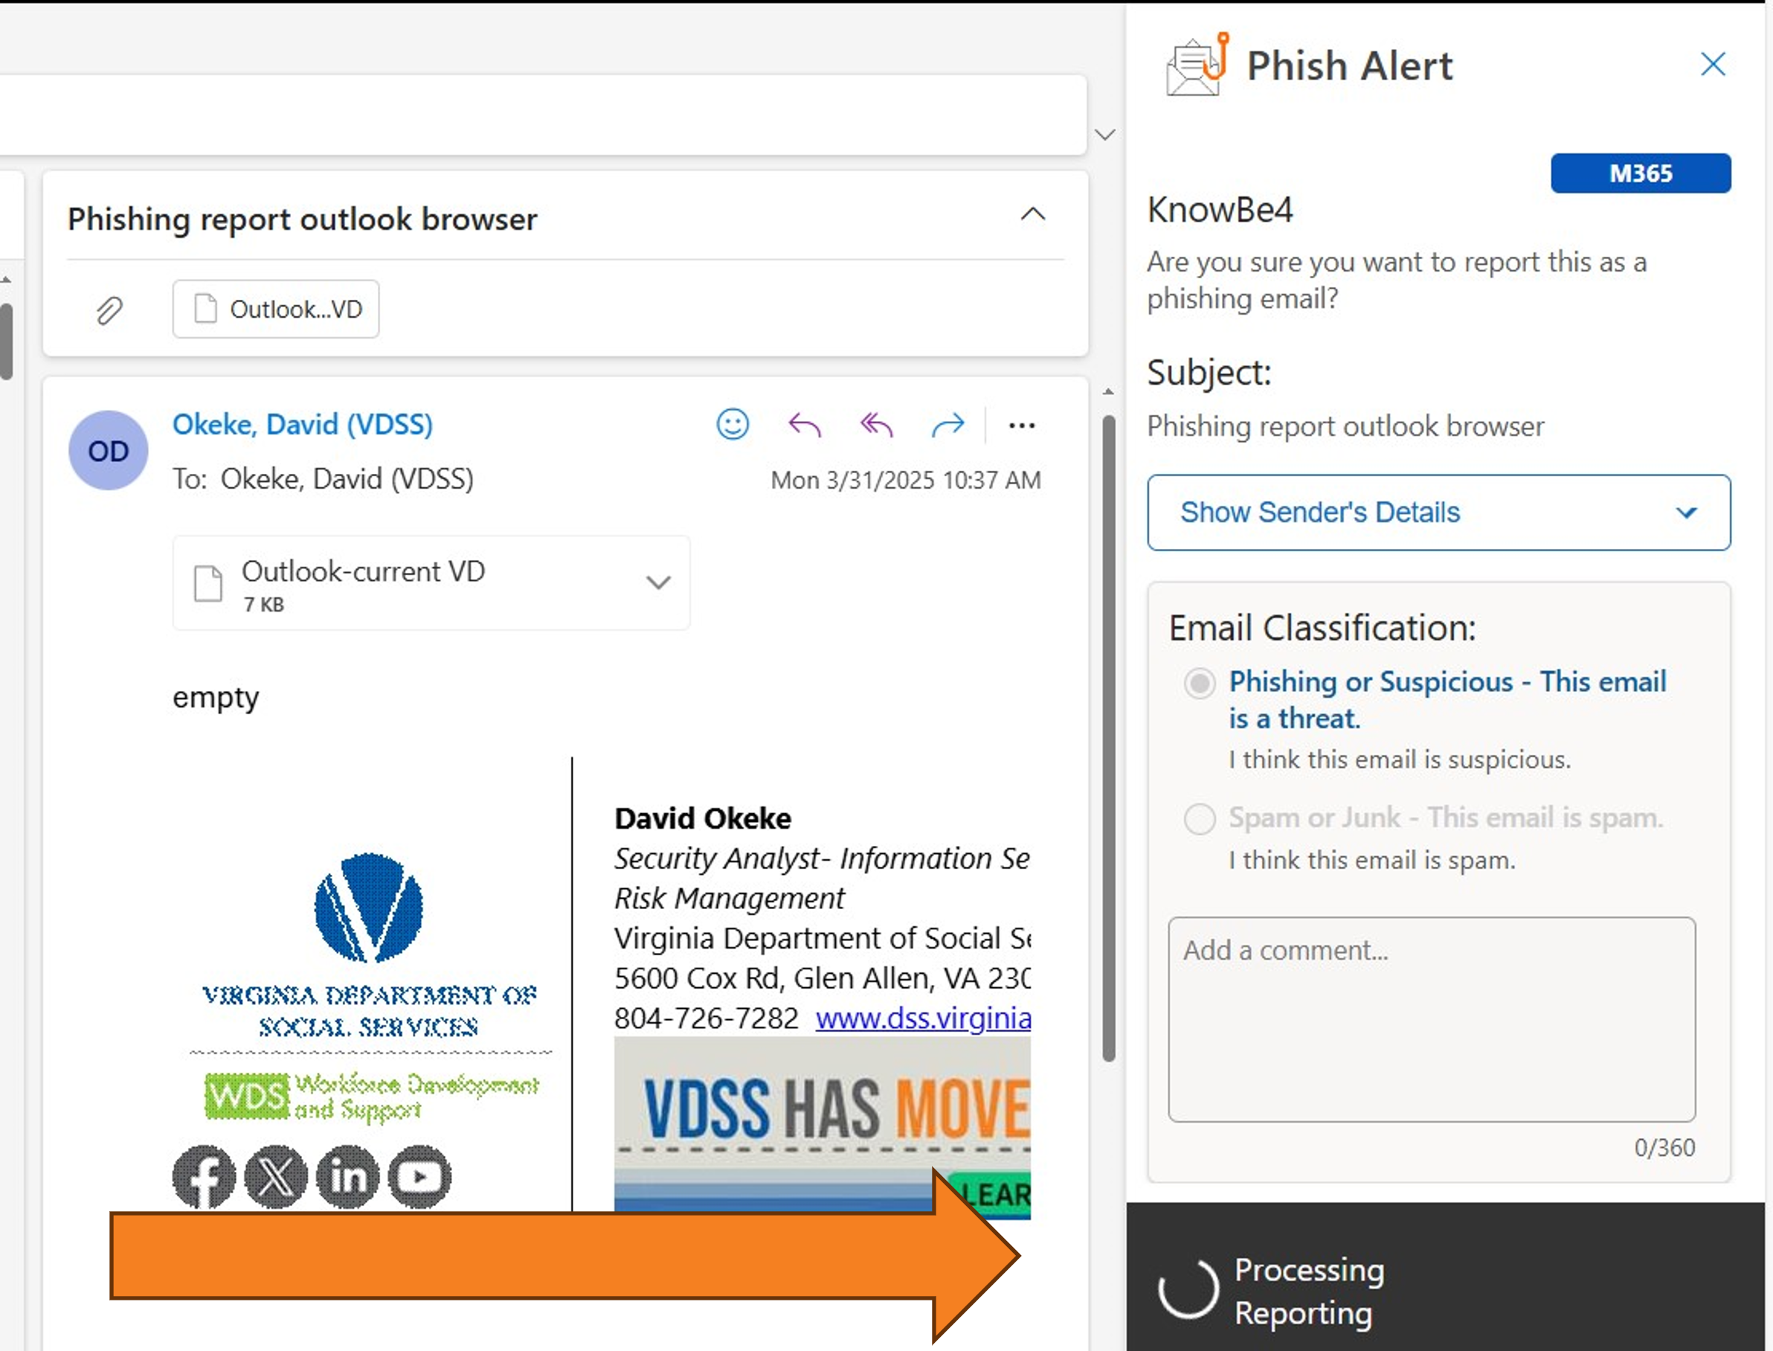
Procedures
Report Phishing Emails with the Outlook through Browser
Once the DSS Phish Alert button has been selected, you may see the Processing Reporting message
Notes:
Procedures
Report Phishing Emails with the Outlook through Browser

Slide 24
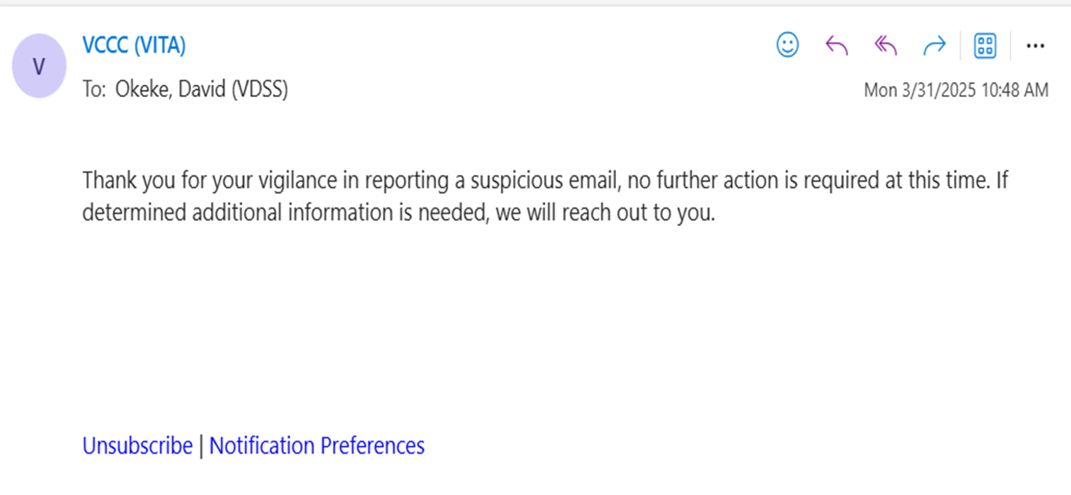
Procedures
Report Phishing Emails with the Outlook through Browser
Once completed, you should receive an email like this
Notes:
Procedures
Report Phishing Emails with the Outlook through Browser
Once completed, the worker should then receive this email

Slide 25
Upcoming LSO Training
Look for a formal notification to all LSOs.
Eastern Region 5/6/2025 Norfolk Eastern Regional Office
Northern Region 5/20/2025, Warrenton Northern Regional Office
Central Region 6/2/2025, Home Office (Glen Allen)
LSOs from any region can attend.
Autumn LSO Training TBA Piedmont/Roanoke, Northern/Warrenton, Eastern/Norfolk, Central/Richmond.
Virtual Training TBA in November.

Slide 26
Open Discussion

Slide 27

Questions
27
Notes:
Questions

Slide 28
Local DSS Applications
If your Local DSS wants to install and use a system that will process or store client data, especially data collected under State/Federal authorities.
VDSS ISO does not have the authority to approve.
Local Director is Accountable to ensure Due Care/Due Diligence (aka required) activities happen for any system that will process or store client data
  Independent Risk Assessment
  System Security Plan
  Corrective Action Plans (to remediate Risk Assessment findings)
  Regular Security Patching (if on premise)
  COVRAMP (third party hosted)
Required stakeholder: City/County Attorney
Required Stakeholder: City/County Chief Information Officer
Required Stakeholder: City/County Information Security Team.

