Slide 1

TRUST
EVERYONE NEEDS IT

Slide 2

Agenda
WHY IS TRUST IMPORTANT TO ALL OF US
DEFINING TRUST
ACTIVITY: WHAT DOES TRUST LOOK LIKE
WHAT EFFECTS OUR TRUST IN OTHERS
ACTVITIY: RATE OUR TEAM
HOW CAN TRUST BE IMPROVED
ACTIVITY: ACTIONS SPEAK LOUDER THAN WORDS
WRAP UP AND SMALL GROUP DISCUSSION

Slide 3
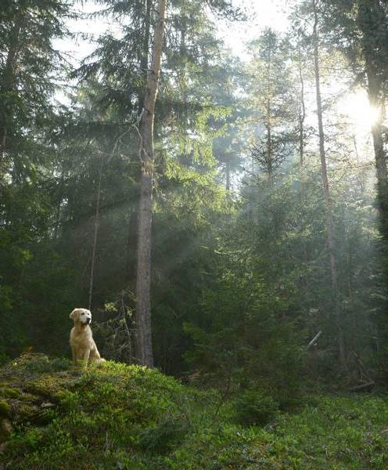
TRUST: WHY IS IT IMPORTANT to all of us?

Slide 4


WHY IS TRUST SO IMPORTANT TO YOU?

Slide 5
IMPORTANCE OF TRUST AT WORK
The outcomes of employee trust on the bottom line are undeniable:
unmistakable impact on employee performance for organizations across industries.
High-trust cultures have half the attrition turnover of industry competitors.
High-trust cultures have accelerated rates of innovation.
High-trust cultures see more employees go above and beyond to deliver for clients and customers.
Do you think it is important to have trust in both your management and co-workers?

Slide 6
Defining trust

Slide 7
Dictionary definition of trust
Trust:
Noun
reliance on the integrity, strength, ability, surety, etc., of a person or thing; confidence.
confident expectation of something; hope.

Slide 8
WHAT DOES TRUST MEAN TO YOU INDVIDUALLY?

Slide 9

COMING UP WITH OUR GROUP DEFINITION OF TRUST

Slide 10
WHAT EFFECTS OUR TRUST IN OTHERS?

Slide 11
WHAT EXPERTS SAY EFFECTS TRUST
Avoiding Conflict. When you discourage disagreement, open discussions can’t occur. Decisions don’t get made, or they are based on incomplete information. Create a psychologically safe place for people to bring up difference among co-workers and management
Breaking promises or Speaking/Acting Inconsistently. When you tell others that you’re going to do something but don’t follow through, trust is lost. Why should others believe you the next time?
Focusing on compliance or shared gain(not personal gain). Share the end goal and have others use their common sense to meet that common goal. Not about outperforming someone, but there should be fairness in division of tasks. True teamwork.
Failing to communicate. You might be reluctant to share some information(especially conflict), but it’s always better to tell the truth than to be silent. Everyone appreciate honesty and not withholding information
Being closed-minded. A trusting relationship doesn’t happen on its own and needs continual work to maintain the balance of this relationship. Being open or committed to working on this with others is important.

Slide 12

ACTIVITY: rate your team
Go thru each person on your team at your locally Agency and rate your trust level with each individual person
Can do the same activity with individuals in your leadership team at your agency as well

Slide 13
ACTIVITY: RATE YOUR TEAM
Select
To start this next activity, select the co-workers you didn’t rate a 5 from activity #1.
Write
Write each name in the table of your activity #2 table
Reflect
Take some time and reflect on what actions or words/situations have caused you to rate your co-worker below a 5
Action
Write the action(s) you thought of for each member. Lower the rate, should be more and different actions listed (up to 3)
Review
Review what action(s) each co-worker did to cause mistrust from you.

Slide 14
How can you build trust?

Slide 15
Name some ways or methods to build or improve trust for you individually.

Slide 16
How to build trust
1. Recognize that building trust takes hard work
Trust must be earned. It comes from a conscious effort to walk your talk, keep your promises and align your behavior with your purpose and values. Building trust is worth the effort because once trust is lost, it can be very difficult to recover.
2. Be honest and supportive
Even when it’s difficult, tell the truth and not just what you think people want to hear. Understand what employees need to know and communicate facts while being considerate of their effort and sensitive to their feelings. Showing support and understanding for your team members, even when mistakes are made. It goes a long way in building trust as a leader.
3. Be transparent
Transparency opens the door for honest conversations, collaboration and respect. It can help take some of the mystery and skepticism out of the workplace that leads to feelings of mistrust. Consistent and regular communications should be a priority for trustworthy leaders, and the communication is best when it’s timely, relevant and focused on what employees need to know and why, so they have context. However, being transparent doesn’t mean needing to have all the answers all the time. The most trustworthy leaders are not afraid of saying “I don’t know, but let me find out and get back to you.”

Slide 17
How to Build trust
4. Be quiet sometimes
Actively listen and check for understanding by paraphrasing what you’ve heard. Use a variety of feedback tools to ensure everyone has the chance for their voice to be heard. You must engage in dialogue with employees, giving them the opportunity to ask questions, get answers, and voice concerns. Do your best to stop “talking at” your employees – they want real, two-way conversations.
5. Be consistent
Consistently doing what you say you’ll do builds trust over time – it can’t be something you do only occasionally. Keeping commitments must be the essence of your behavior, in all relationships, day after day and year after year.
6. Model the behavior you seek
Nothing speaks more loudly about the culture of an organization than the leader’s behavior, which influences employee action and has the potential to drive their results. If you say teamwork is important, reinforce the point by collaborating across teams and functions. Give credit when people do great work and you’ll set the stage for an appreciative culture.

Slide 18
How to build trust
7. Build in accountability
When you and other leaders acknowledge your mistakes as well as successes, employees see you as credible and will follow your lead. You can encourage honest dialogue and foster accountability by building in processes that become parts of the culture, such as an evaluation of every project (positives, negatives, things to change) or a status report and next steps in each meeting agenda (tracking deadlines and milestones).
8. Extend empathy to others
Leaders who pause and imagine how employees truly feel build a lot of trust. Show employees that you hear them and validate their feelings. The payoff is an employee who knows you care; at the same time, you gather information that’s useful to motivating that employee.
9. Solicit feedback and take action on suggestions
We’ve all been here before – we took time to complete an employee engagement survey and then never heard about the results or saw any changes from leadership. From company-wide surveys to simply asking your team members, “what’s on your mind” or “what could we be doing better?” listen actively with a bias for action. Loop back with employees to share an appreciation for their thoughts and help them understand why you are taking certain actions, or conversely, not implementing their approach.

Slide 19
ACTIVITY: REFLECT AND LIST POSITIVE STEPS TO BUILD TRUST

Slide 20
WRAP UP/SUMMARY
WHAT OUR DEFINATION OF TRUST AND WHY DO WE NEED IT?
WHAT ARE METHODS TO AVOID MISTRUST?
HOW CAN WE BUILD TRUST WITH OTHERS?
NEXT STEPS: SMALL GROUP DISCUSSIONS
HOW ARE WE COMMUNICATING OUR ACTIONS THAT INDIVIDUALS CAN IMPROVE UPON TO BUILD TRUST WITHIN THE UNIT?
TIMEFRAME OF PLAN TO COMMUNICATE THIS?

Slide 21




GROUP DECISION
EVERYON SHOULD WRITE DOWN DETERMINED COMMUNICATION PLAN:
WHO RESPONSIBLE?
TIMEFRAME COMPLETED BY?
FEEDBACK/FOLLOW UP?

Slide 22
THANK YOU
Janet Briscoe janet.Briscoe@fcva.us

