Slide 1
Customer Service
First Impressions are Lasting…..Get It Right the First Time!

Slide 2
Topics To Be Covered
How to Avoid Having Issues with Customers with First Impressions
Handling Difficult Clients Before It Gets Out of Control with Communication
De-Escalating the Situation with Upset Customers When All Else Fails
Self Care In the Aftermath of the Customer Departure

Slide 3

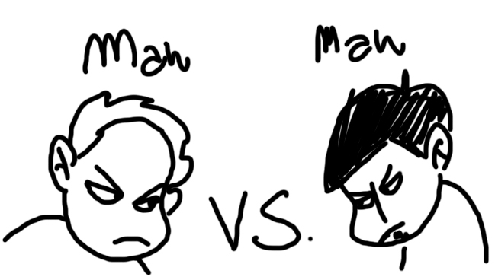
Avoiding Conflict
First impressions are key to deflect anger or frustrations of customer. First impressions are both visual and audio. Let’s look at each type to see what could trigger someone without even realizing it.

Slide 4
Avoiding Conflicts
Visual triggers
Audio Triggers
Facial expressions
  If you look unhappy, the customer will be unhappy
Posture
  Look attentive by sitting up straight and at attention
  Listen to what the client wants or needs
Body Language
  Don’t cross your arms( defensive to others)
  Look at the customer when you speak even if using computer to look up answer
Tone
  It is not just what you say, but how you say it
  Avoid a high pitch or monotone voice
Crowd or Background Noise
  Sometimes customers are very private and do not want to talk in front of people/lobby
  Avoid loud noises or sudden movements
Avoid certain words or phrases, such as:
  Calm Down or Be Patient
  Is everything okay? – they wouldn’t be here if it was

Slide 5

Avoiding Conflict
Avoiding triggers are important, but environmental triggers can happen as well. So think about the following…..
  Customer can’t read or write trying to sign in kiosk or paper in lobby
    If noticing a client having difficulty, don’t make them sign in electronically- you do it for them
  Customer can’t hear very well or physical disability/ have a hard time getting around
    Do we always have to take clients in correct order per the computer?- make the judgement call
  Lobby is full of people……and customer is on a time crunch
    If you don’t already have a drop box in your lobby, you should get one and parameters can be set on what goes in there
These and other items might trigger a frustration or anger even before the customer talks to you!

Slide 6
Role Play Exercise
Scene: A client come off lobby elevator and goes directly to the front desk without signing in, but only needs to drop off a document but doesn't leave desk area.
Communicate: Do Not use any triggers while speaking or prepping to speak with this client to resolve the situation.

Slide 7
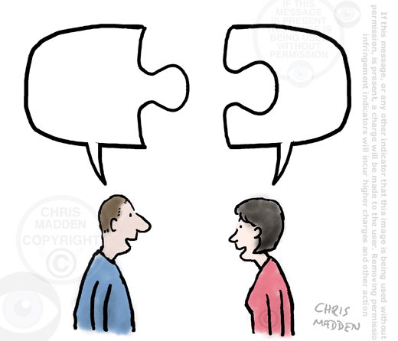
Handling Difficult Clients Using Communication
The best method of handling difficult customers is figuring out which type of communication the customer uses and prefers. If you match communication style, then a conversation becomes much easier and effective for all parties involved!

Slide 8

Handling Difficult Clients with Communication
There are 4 types of communication types in customer service:
  The Director Type
  The Relator Type
  The Analyst Type
  The Socializer Type

Slide 9
Handling Clients Using Communication
The Director Type
The Relator Type
Doesn’t like fluff or small talk….gets to the point
  Immediately go into issue or reason for being there. Time is money in their minds.
Uses short sentences or commands while speaking
  “I “ action statements are key and following thru is important
Likes to make decision(s) on their own
  Give them a few options and let them pick
Wants to belong part of a group or more importantly doesn’t like to be left out
  Ask their opinion…They love to give it! Include them in the decision-making process to be part of the solution.
Wants name of assigned worker and direct contact information
  This gives them the feeling of “networking” and doesn’t like it when this person changes- be prepared
Will share their perceptions of customer service with others
  They will tell everyone they can by email, facebook, in-person, if there was a problem even if just their perception.

Slide 10
Handling Clients Using Communication
The Analyst Type
The Socializer Type
Seeks all information before making a decision
  More details the better for this person. This means you will need to spend more time with them….don’t rush it.
Might be perceived as “wishy washy” on what they want
  Involve the client in the decision-making process once all the facts are given. They may take longer, but they will come to a decision.
Appreciates follow thru or “extra” mile
  If you say you are going to do something, you need to do it. They will follow-up if you did or not. If you did, they will be very complimentary because they like the “extra” care.
Wants to create that friendship on an individual level
  Use their name when taking to them
  Build that trust because if not will not believe you even if are correct
Seeks long conversations that have nothing to do with why they are here
  Let them talk. This might be there only interaction of the day.
  No data is needed to make them happy

Slide 11
Role Play Exercise
Scene: The client is unhappy about the progress on their eligibility case and wants answers now.
Communication: Use the different types of communication to see what fits best for this clients and make the adjustment to hep resolve the situation without a supervisor.

Slide 12

De-Escalating the Situation
When all our conflict avoidance techniques and communication tips fail and the client continues to be upset or angry with any change in demeanor, we need to try to de-escalate the situation to the best of our abilities. How we de-escalate the situation can vary and we need to pick the best solution for the situation.

Slide 13
De-Escalating the Situation
Diffuse The Situation By Your Actions
  Stay calm and composed while the conversation is happening
  Maintain your tone- Don’t get louder or higher pitched
  Make them feel heard. Their problem is very real and serious to them and they want someone to care about it.
  The answer is never just “no”. Offer other alternatives or resources in community or other Agency workers to see them.
  Going the extra mile and getting the worker personally or getting an answer if the worker isn’t available

Slide 14
De-Escalating the Situation
Relate With The Person
  Relate on the level for their frustration. Understanding their frustration is different then understanding their personal situation of why they are here. Do NOT go there….this will infuriate them more!
Remove Them From The Lobby
  Utilize rooms or offices off of your lobby area(if possible) to meet with them and have someone else cover the front or have the eligibility worker meet them.
  If you feel uncomfortable at any time to meet a client by yourself, always bring in a supervisor or co-worker for the buddy system

Slide 15

De-Escalating the Situation
When all else fails…..
  Get a Supervisor. Sometimes that is all it takes because they feel their issue will get resolved.
  If client can’t calm down, you have the right to hang up or ask them to leave the premise.
    If you do, please give warning(s) to the client before hand. Also let them know they can come or call back to resolve their problem calmly because we do want to help.
  If client refuses to leave and is a disruption, then call the police to remove them
  If client continues to call back continuously, let the call go and have them leave a message.
    Make sure you tell someone about the situation, so your supervisor is aware of this.

Slide 16
Role Play Exercise
Scene: The client is unhappy about the progress on their children being potentially removed from the home and some worker went to talk to them at school. The client is not taking no and challenging every answer and behaving badly.
Communication: How would you try to not let this escalate and but what happens if all else fails?

Slide 17
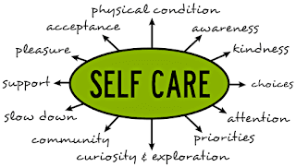
The Aftermath: Self-Care
After the incident or situation ends, we forget to take care of ourselves in the process. These situations affect us as well as the client. It is important to do some self-care before going on to the next customer like nothing happened. We owe it ourselves or else reactions or perceptions can be tainted for the next person.

Slide 18
The Aftermath: Self-Care
Self-Care Suggestions
Agency Care Suggestions
Take break from the front desk or phones
  Physically get up and move around- take a walk
Deep Breathing Techniques
  There are various techniques like square breathing to de-stress or lower anxiety
Talk to Someone
  It helps to talk about it to debrief and understand what just happened.
Others in the lobby could also be feeling” some kind of way” from what happened
  Recognize what happened and see if everyone is okay as you speak with them – they sure will with each other.
  If someone is really bothered have them wait and talk to someone before leaving, so they leave feeling okay as well.
Make sure someone is near by and can cover or take a second window while the situation is happening or after
  Sometimes it helps us and others knowing there is a team taking care of them and more than 1 person knows what is going on.

Slide 19

The Aftermath: Self-Care
Some other suggestions….
  Get a drink of water
  Stretch- might seem weird but does really work
  Listen to music
There is nothing wrong with you taking time to decompress. It is better for the agency because then when you are back in front or phones, your first impressions will be spot on again!

Slide 20
Discussion:
How do you self care after these situations?

Slide 21
Questions
Janet Briscoe
Janet.Briscoe@fcva.us

