Slide 1
Financial Resources Available on FUSION
POSSESS Quarterly Meeting Presentation
December 18, 2025

Slide 2
Resources on FUSION
Budget
Expenditures
LASER Resources
Training
Random Moment Time Study (RMTS)
Reports
Other Resources

Slide 3
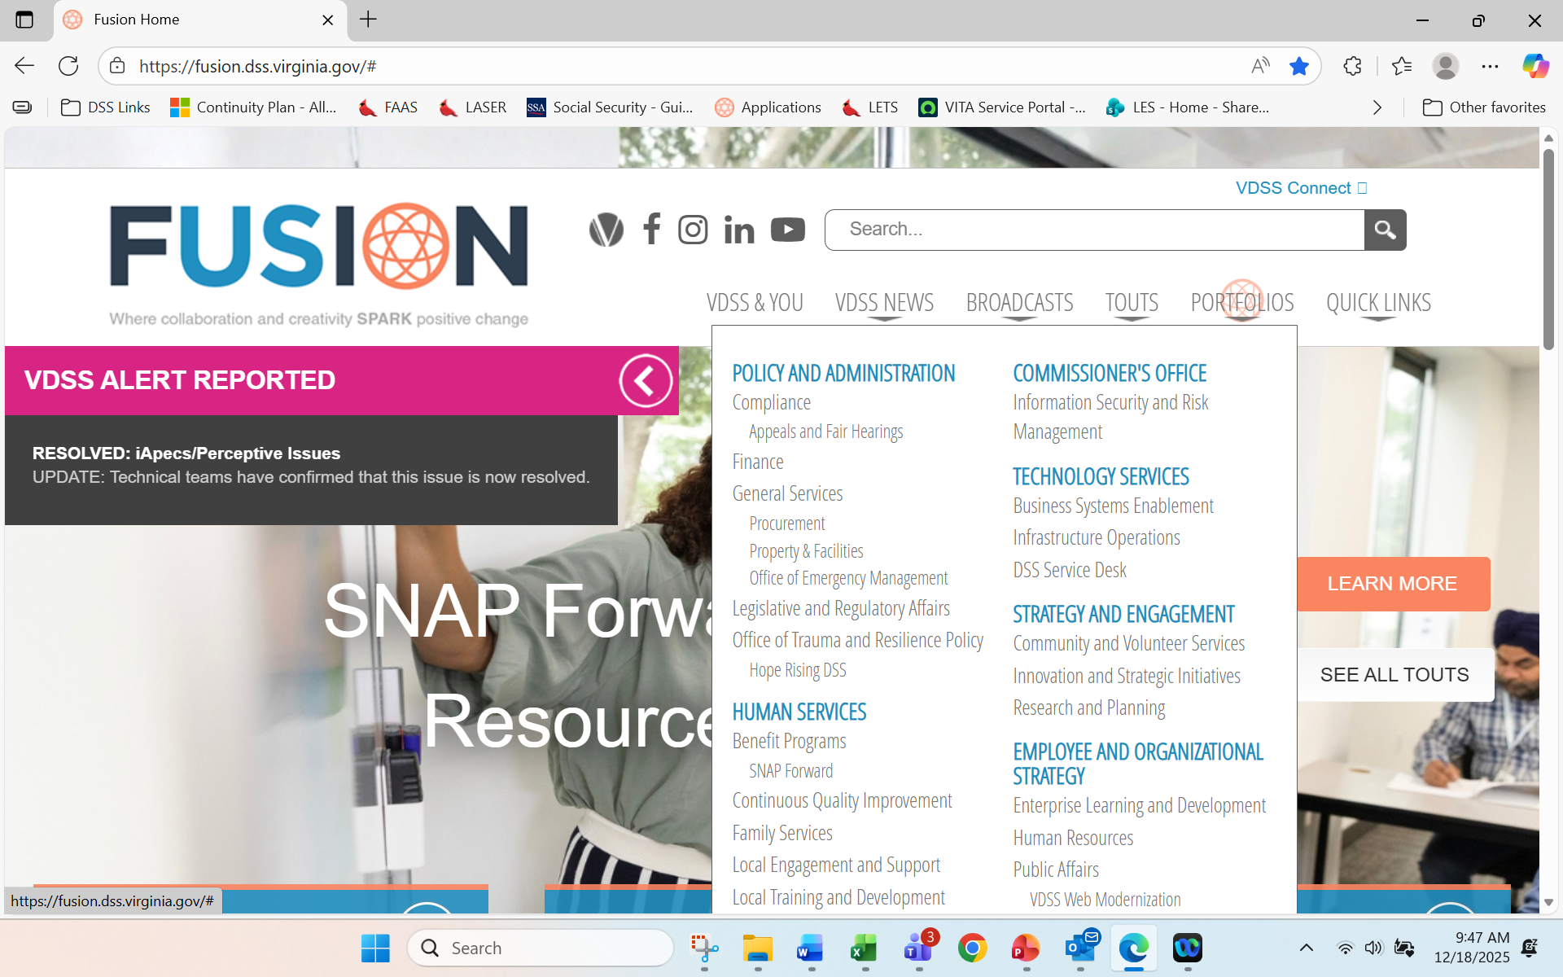
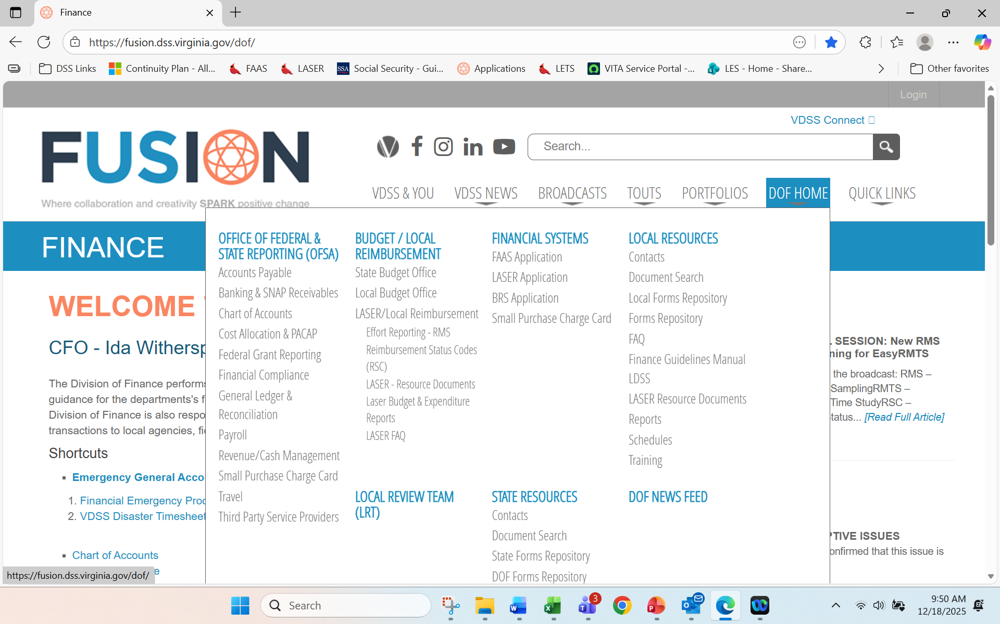
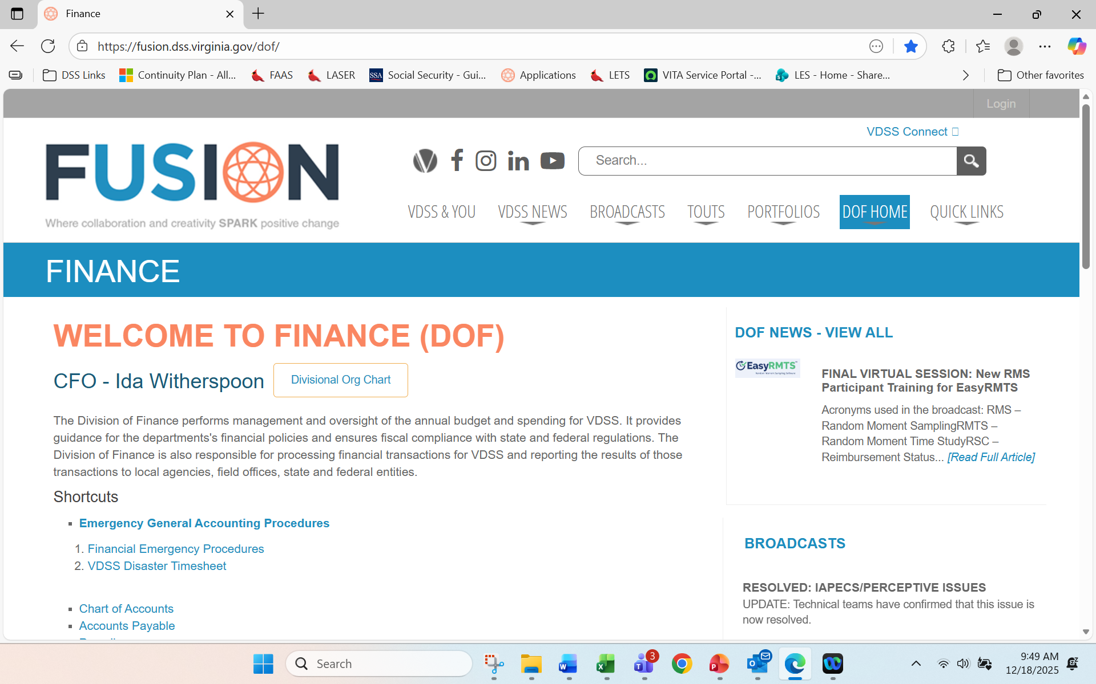
From the Home Screen on FUSION select Portfolios
From the DOF Home Drop Down Box Select the Appropriate Topic
https://fusion.dss.virginia.gov/dof/
From the Finance Home Screen on FUSION select DOF Home

Slide 4

Budget Resources Available on FUSION
Guidance
BRS Approval Contacts
FY2026 Mid-Year Review
FY2026 Final Local Budget Letter 05.13.2025
FY2026 Local Government Bonus Certification - Revised 05.13.2025
FY2026 Preliminary Local Budget Guidance Letter 03.28.2025
FY2025 Mid-Year Review
FY2025 Final Local Budget Update Letter 05.17.2024
FY2025 Preliminary Final Local Budget Guidance Letter 5.1.24
FY2025 Preliminary Local Budget Guidance Letter 3.29.24
FY2024 Final Guidance Update Letter Chapter 1
FY2024 Local Budget Update Letter
FY2024 Preliminary Final Local Budget Letter
FY2024 Preliminary Local Budget Guidance
FY2023 Final Local Budget Update Letter
FY2023 Preliminary Final Local Budget Letter
FY2023 Preliminary Local Budget Guidance
Laser Budget Lines & Cost Code Descriptions (see LASER Guidance & Procedures)
Local Match Rates
Mandated Budget Lines_2025
Procedures for Local Budget Administration
Program and Budget Staff Assignments
https://fusion.dss.virginia.gov/dof/DOF-Home/BUDGET-LOCAL-REIMBURSEMENT/Local-Budget-Office

Slide 5

Expenditure Resources Available on FUSION
Contacts
Local Finance Guidance Manual
Training
Schedules
Reports
Forms
FAQ
LASER Resource Documents
https://fusion.dss.virginia.gov/dof/DOF-Home/LOCAL-RESOURCES

Slide 6
LASER Resources Available on FUSION
LASER Resource Documents
LASER Account Codes
LASER Adjustments
LASER Master Table FY 2024
LASER Master Table FY 2025
LASER Master Table FY 2026
LASER Overview
LASER Supported Report Sets
Mandated Budget Lines - FY26
https://fusion.dss.virginia.gov/dof/DOF-Home/BUDGET-LOCAL-REIMBURSEMENT/LASER-Local-Reimbursement/LASER-Resource-Documents
LASER/BRS Forms
Central Services Cost Allocation Plan certification
Combined LASER Certification and Reconciliation
LASER Expenditure Certification
LASER Expenditure Reconciliation Form
LDSS Director Signatory Designee Authorization
LDSS SNAPET Grant Reimbursement Worksheet
LDSS Unwinding Worker Certification Form
Office Space Questionnaire
Client Affidavit for Goods&Svcs Received
Client Purchase Request Form
LASER/BRS Access Request Form
Gift Card Affidavit
Gift Card Log Sheet
Gift Card Request Form
https://fusion.dss.virginia.gov/dof/DOF-Home/BUDGET-LOCAL-REIMBURSEMENT/LASER-Local-Reimbursement

Slide 7
LASER System Resources Available on FUSION
(Continued)
Guidelines & Procedures
BRS_Request_worksheet_BL858_FY 2026.xlsx
Capabilities
FAQ
BRS User Documentation - Transfer Process
https://fusion.dss.virginia.gov/dof/DOF-Home/FINANCIAL-SYSTEMS/BRS-Application
Forms
LDSS LASER BRS Access
VDSS LASER BRS Access
Guidance & Procedures
LDSS Laser Support and Guidelines
VDSS Security User Setup Table
https://fusion.dss.virginia.gov/dof/DOF-Home/FINANCIAL-SYSTEMS/LASER-Application
LASER Schedules
Month-End Schedule (2026 FY)
Month-End Schedule (2025 FY)
https://fusion.dss.virginia.gov/dof/DOF-Home/BUDGET-LOCAL-REIMBURSEMENT/LASER-Local-Reimbursement

Slide 8
LASER Training Resources Available on FUSION
LASER Training/Tutorials
Creating Batches & Journals
FIN1015 Budget Review
FIN1044 LASER - An Introduction to LASER
FIN1045 LASER - The LASER Expenditure/Reimbursement Process
FIN1046 LASER Reports
FIN1027 Central Services Cost Allocation Plan (CSCAP)
FIN1029 Internal Control
FIN1031 Finance Overview
FIN1032 Budget Request System
LASER - How to Run Monthly Certification and Reconciliation Reports
LASER - Responsibilites aren't on menu
LASER Login Screen
LASER Overview and System Navigation-June 2025
LASER Reports - How to Run
LASER Web ADI
LASER - How To Correct a Funds Failure
LASER Certifications and Reconciliations Reminders
https://fusion.dss.virginia.gov/dof/DOF-Home/LOCAL-RESOURCES/Training

Slide 9
RMTS Resources Available on FUSION
Guidance & Procedures
RmsPLUS Activity Code Definitions
RmsPLUS Coding Guidance
RmsPLUS Instructions
RmsPLUS Program Code Definitions
RmsPLUS Program and System Contacts
RmsPLUS Quality Control Validation Instructions
RmsPLUS Roles and Responsibilities
RmsPLUS What is RMS and why is it important
RmsPLUS Worker Desk Reference and Process Flowchart
RMS Resource Documents
EasyRMTS Coordinator Presentation October 2025
EasyRMTS Coordinator Roster Guide
EasyRMTS Facilitator Presentation October 2025
EasyRMTS Facilitator Quick Guide
EasyRMTS Participant Presentation October 2025
RMS Schedules
(FY 26) RMS Schedule
(FY 25) RMS Schedule
https://fusion.dss.virginia.gov/dof/DOF-Home/BUDGET-LOCAL-REIMBURSEMENT/LASER-Local-Reimbursement/Effort-Reporting-RMS

Slide 10
Reports Available on FUSION
Local Review Team Quarterly Reports
2025 FY
4th Quarter (ending June 2025)
3rd Quarter (ending March 2025)
2nd Quarter (ending December 2024)
1st Quarter (ending September 2024)
2024 FY
4th Quarter (ending June 2024)
3rd Quarter (ending March 2024)
2nd Quarter (ending December 2023)
1st Quarter (ending September 2023)
LASER Budget & Expenditure
Reports
https://fusion.dss.virginia.gov/dof/DOF-Home/LOCAL-RESOURCES/Reports
Financial System (LASER Report Macro)
Revised Create Macro for Oracle Reports in MS 2013_2016-Revised 2017_05_18.pdf

Slide 11
Other Resources Available on FUSION
Manuals
Local Agency Administration
https://fusion.dss.virginia.gov/les/LES-Home/Resources/Local-Administrative-ManagersHandbook
Local DSS Boards
https://fusion.dss.virginia.gov/Portals/%5bro%5d/Files/08.3_Local Director Orientation/lb_handbook.pdfHandbook
Family Services (DFS) - Child and Family Services Manual
E. https://fusion.dss.virginia.gov/dfs/DFS-Home/Foster-Care/Foster-Care-Guidance
I. https://fusion.dss.virginia.gov/dfs/DFS-Home/Title-IV-E/Title-IV-E-Guidance
https://fusion.dss.virginia.gov/home/manuals
State Travel Regulations
https://www.doa.virginia.gov/reference/CAPP/CAPP_Topics_Cardinal/20335-2019-July.pdf

Slide 12


